Slide 1
Gametogenesis
It is the formation of gamete male (microgametogenesis) and gamete female (megagametogenesis) in reproductive part.
Definition
Pollen grain is a tiny substance produced by flowers. These grains can have various shapes. They produce and contain male reproductive cells, and enable their movement.

Slide 2
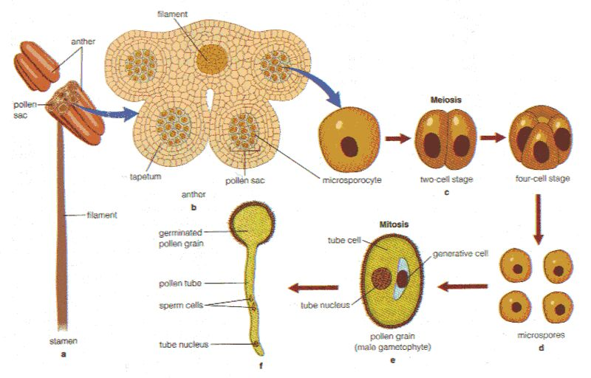

Slide 3
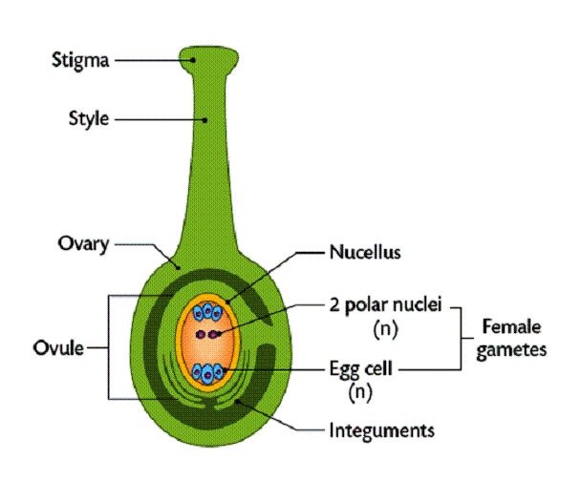

Slide 4
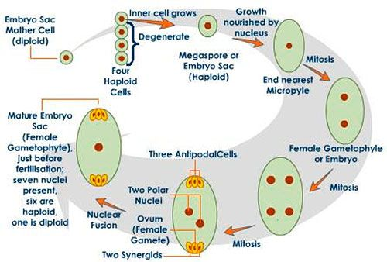

Slide 5
THE POLLINATION
It is the transport of pollen from the organs to reproduce the files in the organs Reproduction of females
This transport can be used in different ways: by the vent, by the animals (tels of the insects) or by other people.
The plant parts and flowers are incapable of former grains and fruits in the absence of Pollination,
Types of pollination:
The pollen transport can be used:
Enter the reproduction organs of a mother’s fleur
There are different types of flowers on the same plant
Different types of plant flours

Slide 6
2, Fertilization generally describes the fusion of haploid gametes (pollen grain and ovary) to initiate the development of a new diploid organism.
Pollination is the act of transferring pollen grains from the male anther of a flower to the female stigma.
Double fertilisation This process is unique to angiosperms. It comprises of two phenomenon: Syngamy and Triple fusion

Slide 8
C. POST FERTILISATION: STRUCTURE AND EVENTS
After fertilisation, the zygote divides to form the embryo and the endosperm develops further
① Endosperm
The endosperm formed is a triploid structure (n3). Its development proceeds the development of the embryo. The endosperm provides nutrition to the developing embryo. On the basis of development, the Endosperm can be of the following types
• Nuclear Endosperm: The division of the primary endosperm nucleus where the nuclear divisions are not accompanied by the wall formation. This leads to the formation of a structure that has many nuclei suspended in the sap.

Slide 9
Cellular Endosperm: The division of the primary endosperm nucleus results in the formation of multinucleate condition with regular wall formation. In coconut, the water is actually free nuclear endosperm, while, the white kernel is the cellular Endosperm.
• Helobial Endosperm: It is found mostly in the monocotyledons. Half the endosperm is cellular and half is free nuclear.

Slide 10
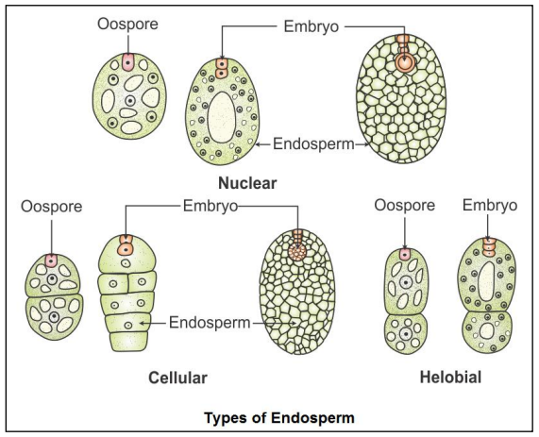

Slide 12
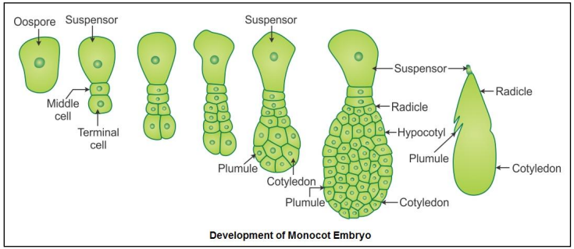

Slide 13
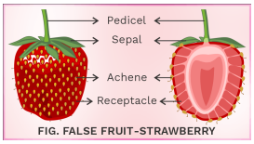
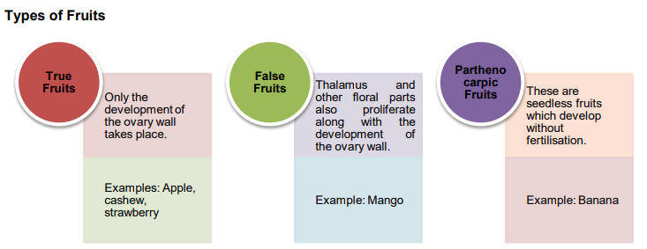
FRUIT: development of The ovary matures into a fruit after fertilisation. There are two types of fruits formed:

Slide 14
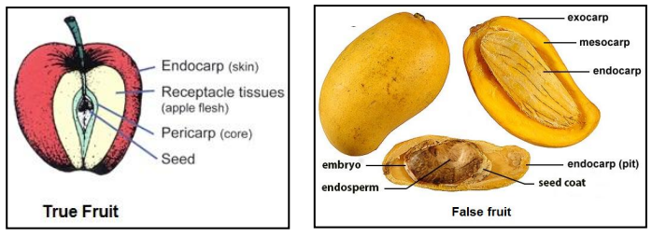

Slide 15
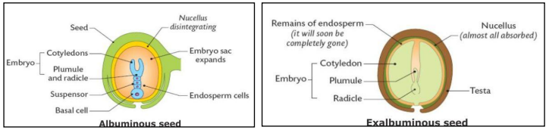
SEED
The ovules in the ovary develop into the seeds. The seeds are basically of two types:
○ Albuminous or Endospermic: These seeds that have a large amount of endosperm. Example: Wheat, Maize, Onion
○ Non-Albuminous or Non–Endospermic: These are the seeds in which the endosperm is used up during the course of development. They store food in their cotyledons.

Slide 16
2. NOTION OF DEVELOPMENT CYCLE
A. Germination
Germination is a process by which the embryo in the seed becomes activated and begins to grow into a new seedling.
absorption of water (When conditions are right, water is absorbed very rapidly through the micropyle).
Phase of germination The moisture triggers an increase in cellular respiration, Metabolic activity surges, Proteins are synthesized and Gibberellins stimulate the production of enzymes. The enzyme protease breaks down stored proteins into amino acids. The sugars and amino acids are directed towards cell division, growth, and differentiation sites at the root and shoot meristems or tips. Metabolic processes increase. The swelling of cells causes the seed coat to rupture. The primary root or radicle emerges downward, and the stem grows upwards.
PHASE 3 ELONGATION OF RADICAL, The shoot begins manufacturing food through photosynthesis and the roots absorb water and nutrients.

Slide 17
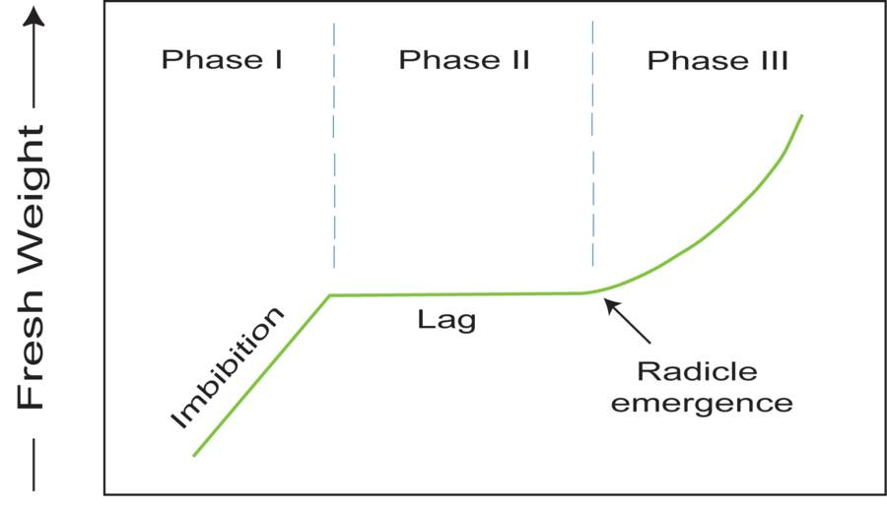

Slide 18
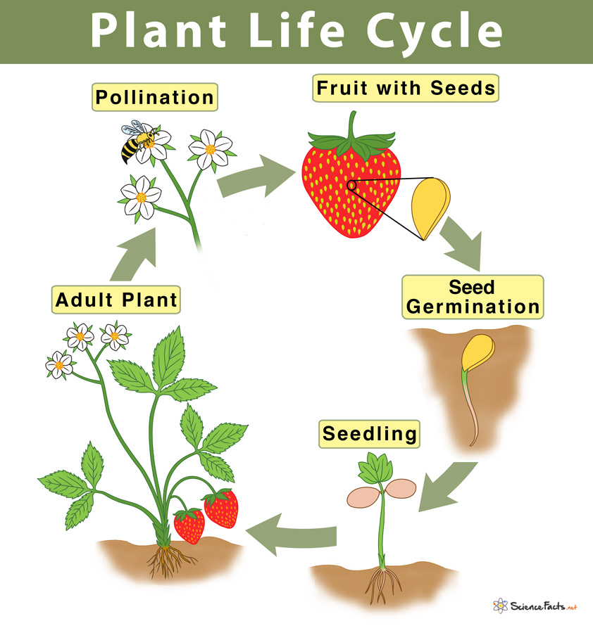

Slide 19


