Slide 1
Basics of HYSYS and exploring its GUI, create Component lists and select components then see Basic & Critical Properties for components. Create Hypothetical Component.
Process Simulation in Chemical Engineering BSc

Slide 2
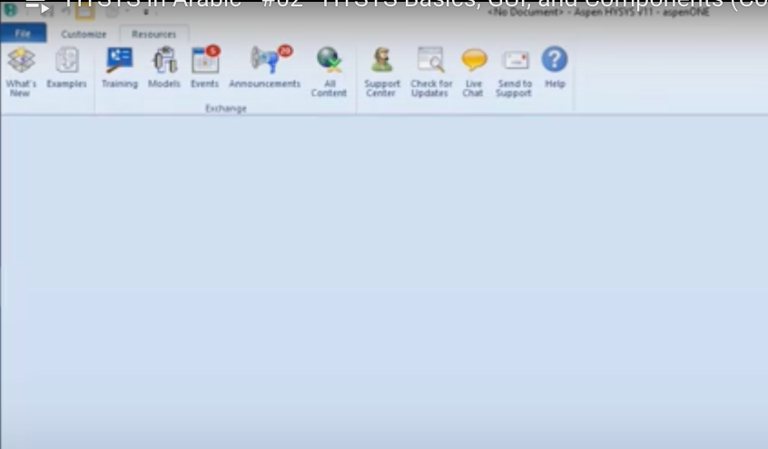
GUI exploring
Hysys is similar of a system to the Office Microsoft.
To open a new program, simply click the New Project button

Slide 3
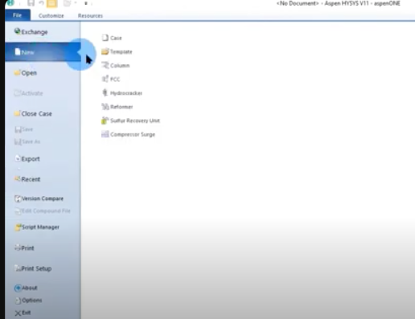
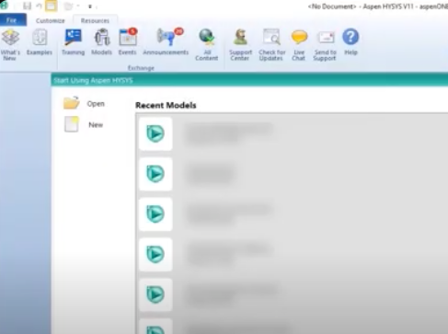
GUI exploring

Slide 4
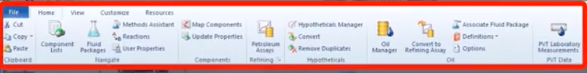
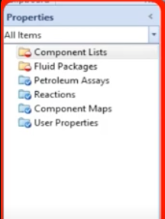
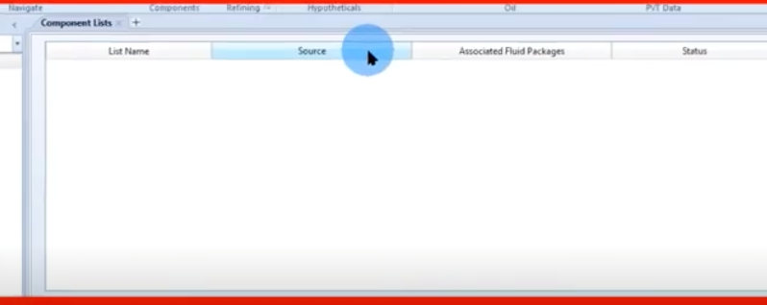
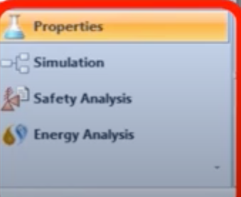
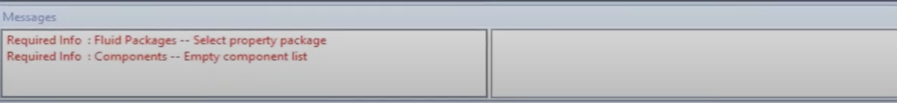
GUI exploring

Slide 5
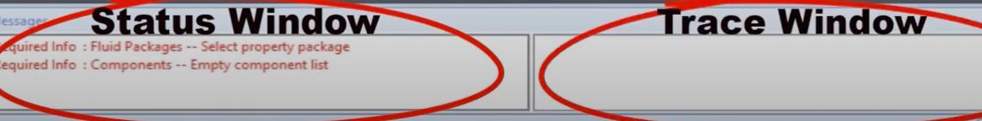
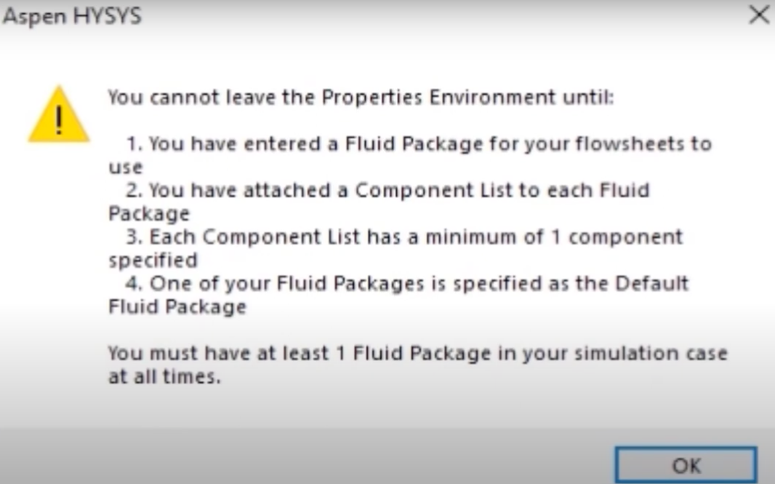
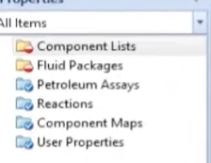
GUI exploring

Slide 6
To select a property package in HYSYS simulation process and create a hypothetical component, you can follow these steps:
1. Open HYSYS: Launch the HYSYS simulation software.
2. Create a New Case: Start a new simulation case or open an existing one where you want to add the hypothetical component.
3. Define Hypothetical Component: If you haven't defined the hypothetical component yet, you need to create it first. To do this, go to the "Components" tab in the Simulation Basis pane on the left side of the HYSYS window. Right-click on "Components" and select "New Component." Enter the necessary information for the hypothetical component, such as its name, molecular weight, critical properties, etc. Once you have defined the component, click "OK" to save it.

Slide 7
4. Select Property Package: After defining the hypothetical component, you need to select a property package that includes the necessary thermodynamic models for your simulation. Go to the "Simulation Basis" pane and click on the "Packages" tab. Here, you'll find a list of available property packages.
5. Evaluate Options: Review the available property packages and evaluate which one best suits your simulation needs. The choice of property package depends on factors such as the type of process you're simulating, the components involved, and the accuracy required.
6. Select Property Package: Once you've decided on the appropriate property package, right-click on it and select "Set as Active." This will set the selected property package as the active one for your simulation case.

Slide 8
7.Add Hypothetical Component to Simulation**: Now that you have defined the hypothetical component and selected the property package, you can add the component to your simulation. Go to the "Flowsheet" pane, click on the "Components" tab, and drag the hypothetical component from the Components list onto the flowsheet. You can place it wherever it's relevant in your process simulation.
8. Configure Component Properties: Double-click on the hypothetical component icon on the flowsheet to configure its properties if necessary. You may need to specify additional parameters such as vapor pressure, enthalpy, etc., depending on your simulation requirements.
9. Save Changes: Once you have added the hypothetical component and configured its properties, make sure to save your simulation case to retain the changes.
By following these steps, you can select a property package and create a hypothetical component in HYSYS simulation for your process modeling needs.

Slide 9
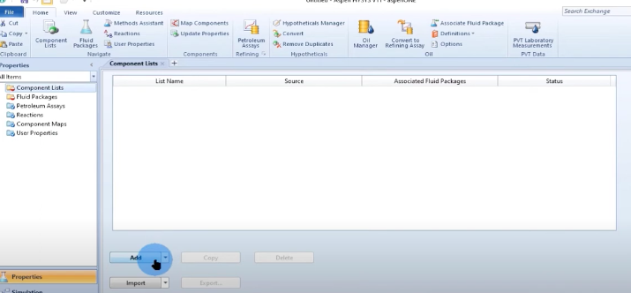
Component lists

Slide 10
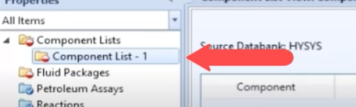
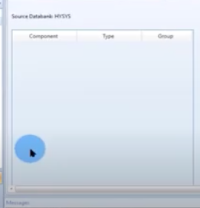
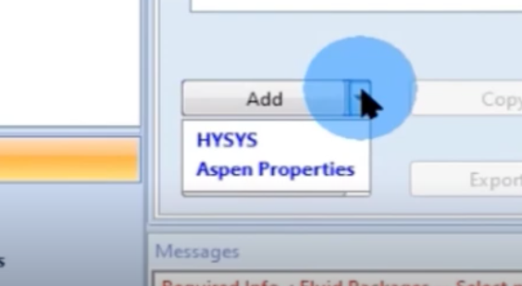
Component lists

Slide 11
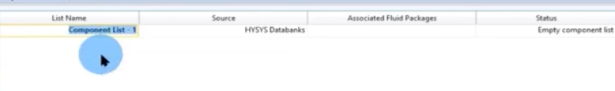
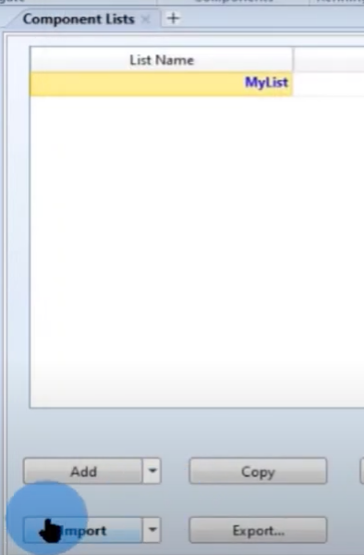
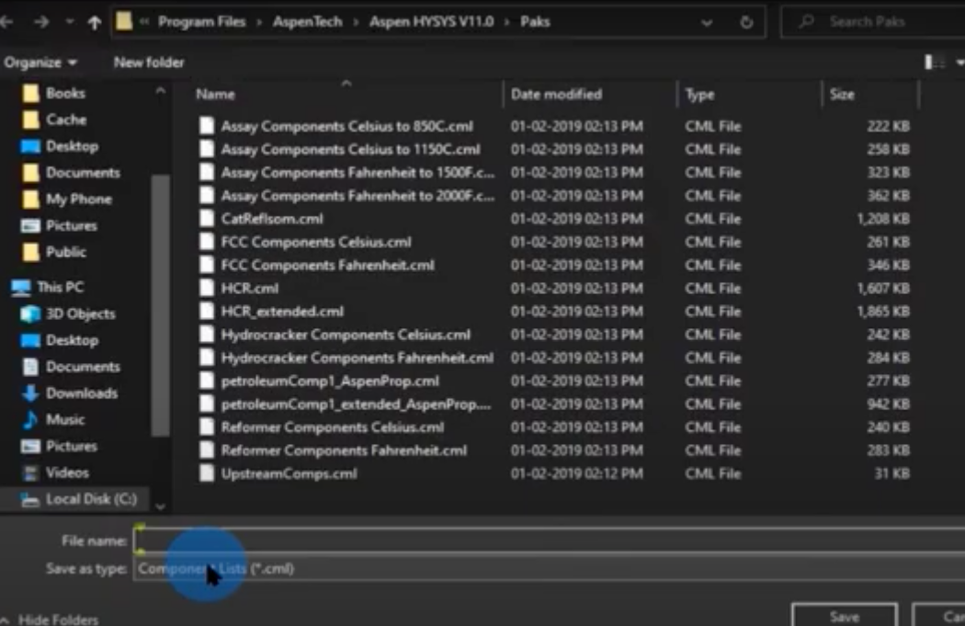
Component lists

Slide 12
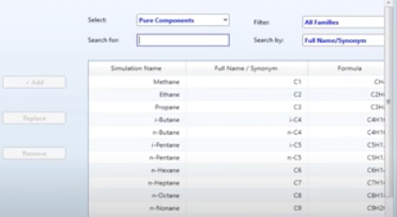
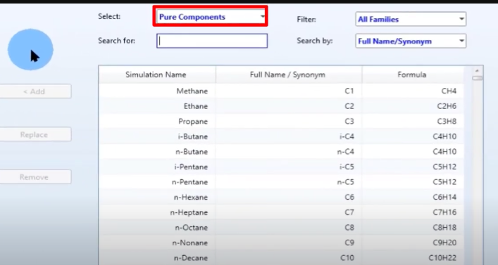

Component lists

Slide 13
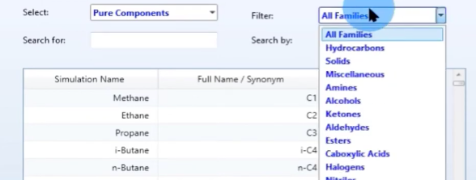
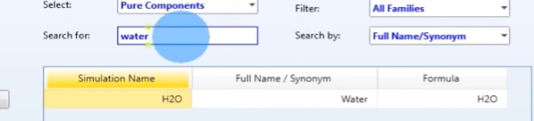
Component lists

Slide 14
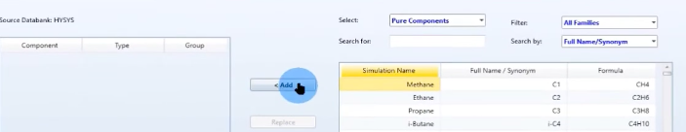
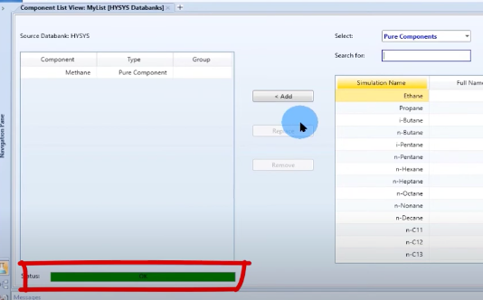
Component lists

Slide 15
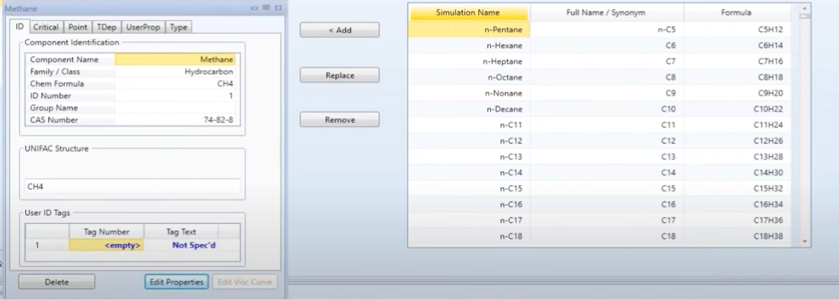
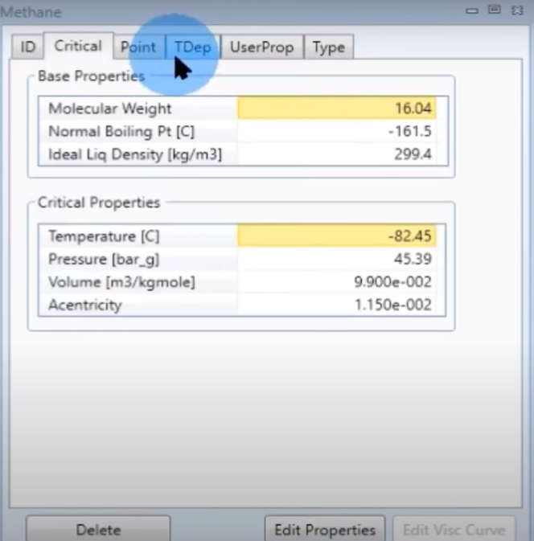
Basic & Critical Properties

Slide 16
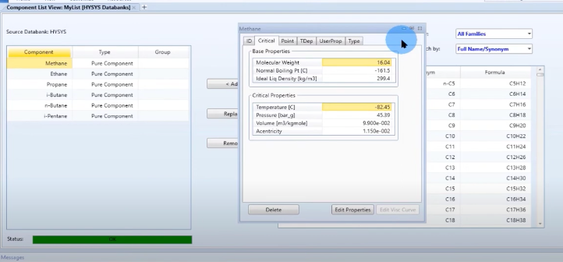
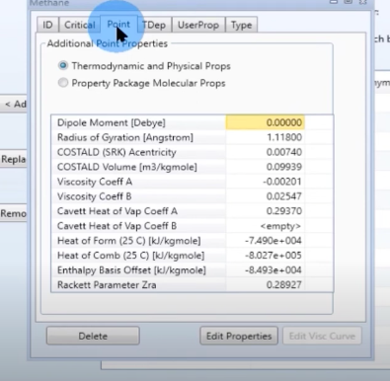
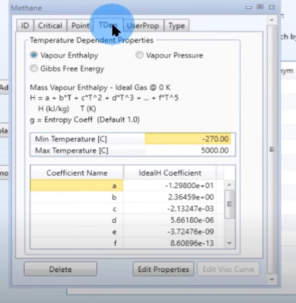
Basic & Critical Properties

Slide 17
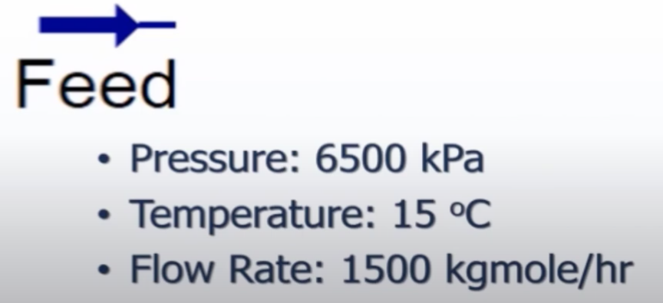
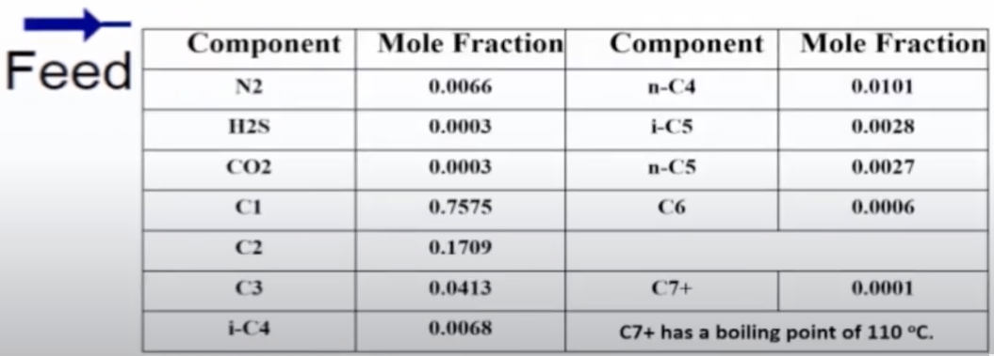
Example Given Data

Slide 18
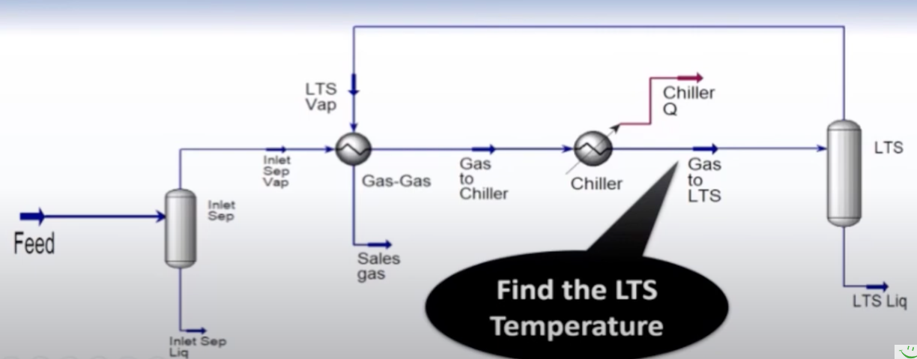
Example Given Data

Slide 19
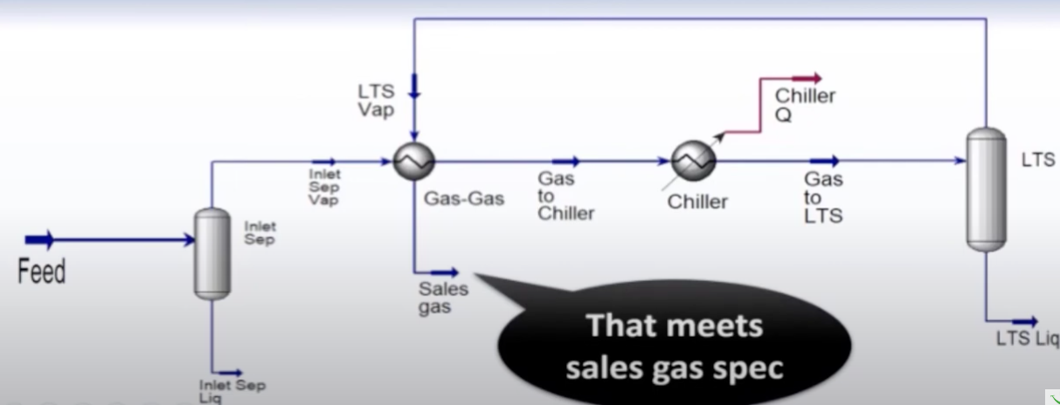
Example Given Data

Slide 20
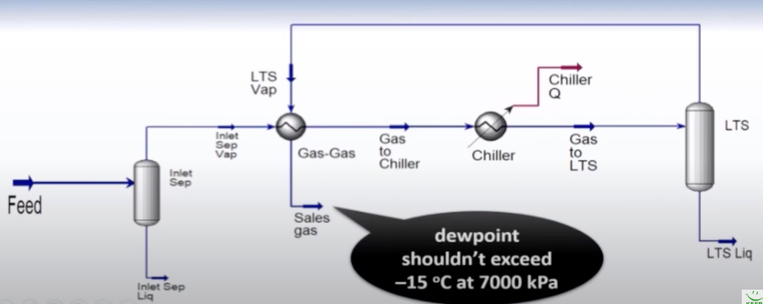
Example Given Data

Slide 21
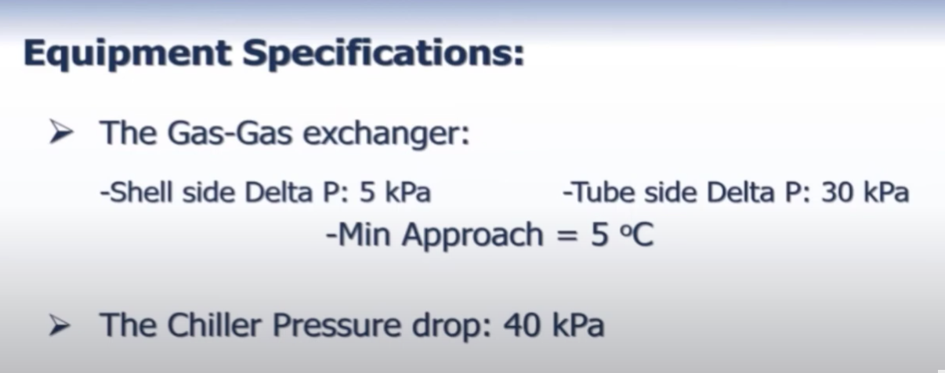
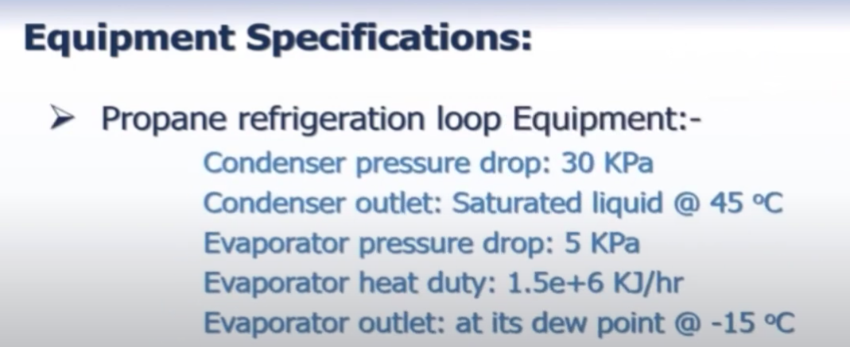
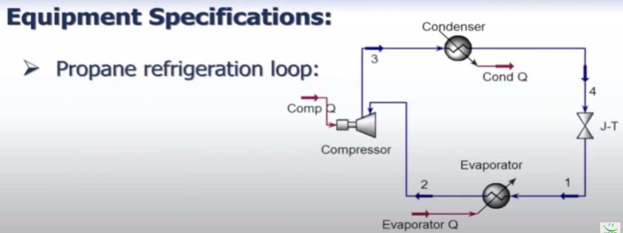
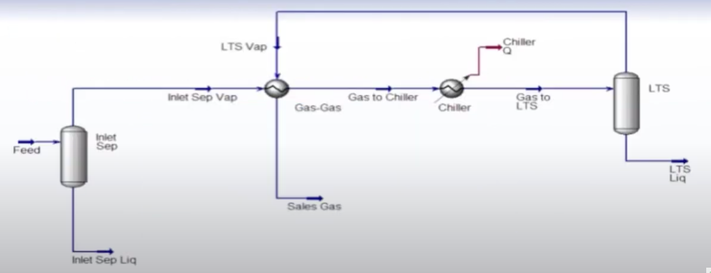
Example Given Data

Slide 22
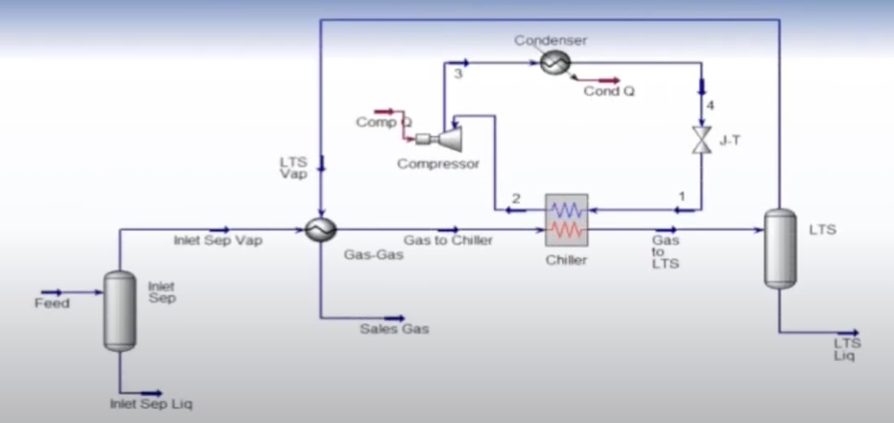
Example Given Data

Slide 23
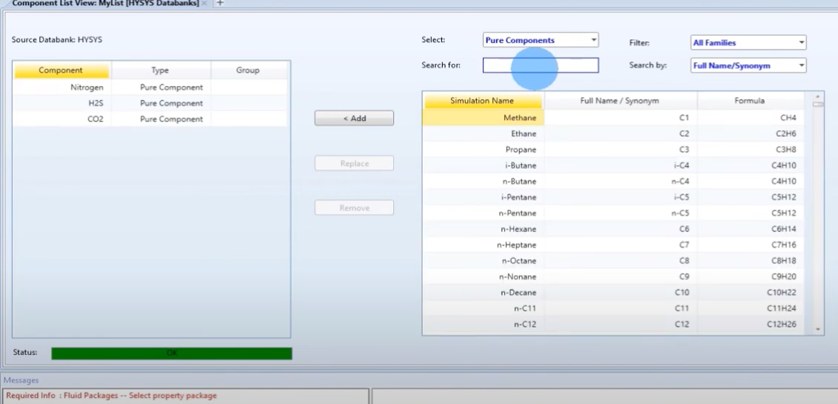
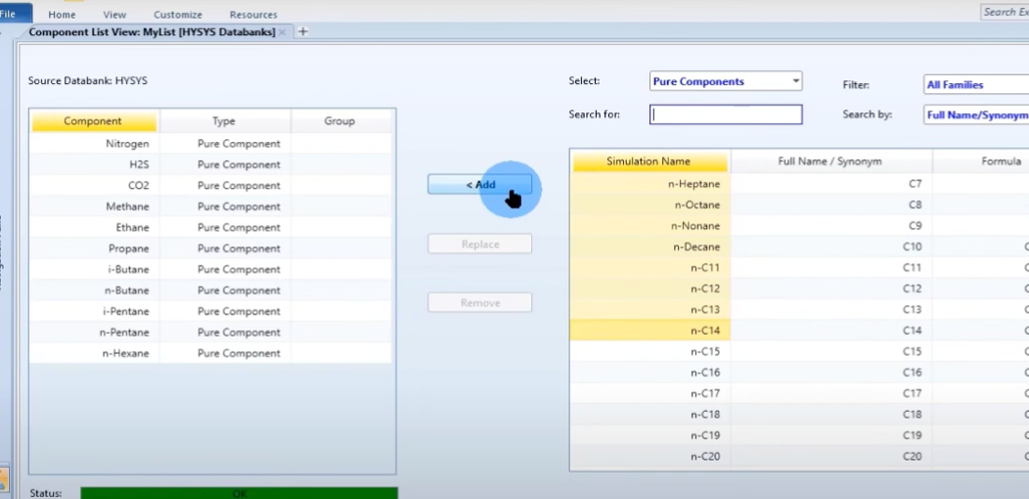
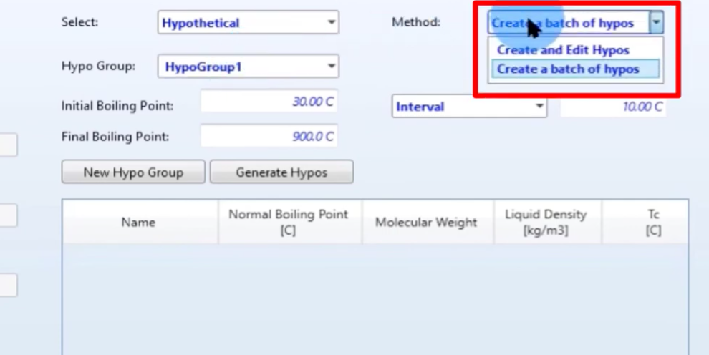
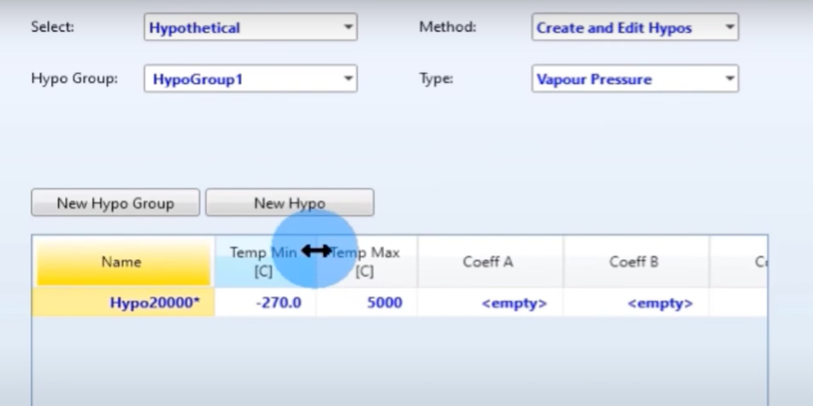
Example Given Data

Slide 24
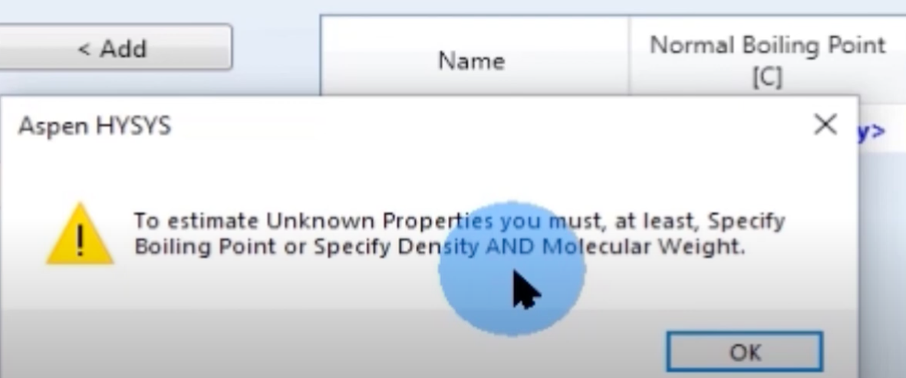
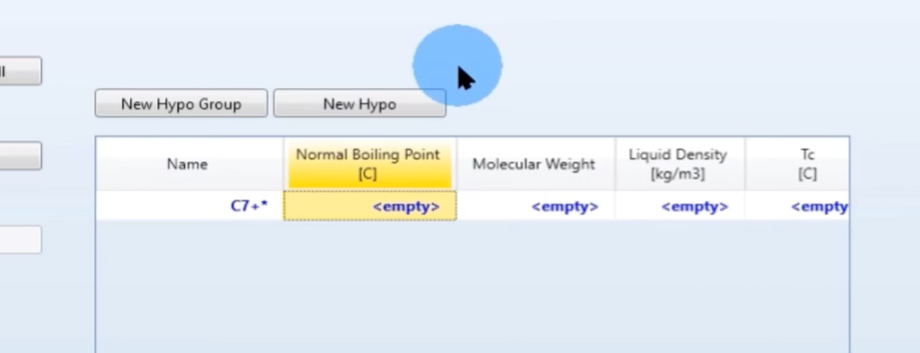
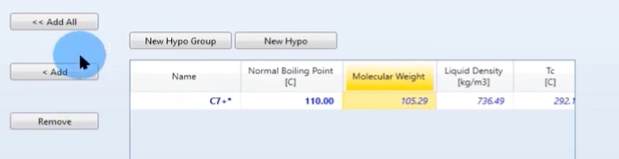
Example Given Data

Slide 25
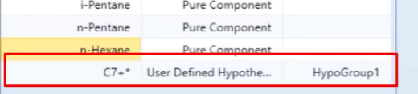
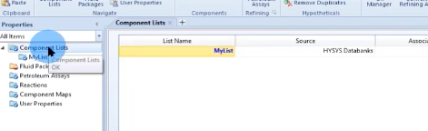
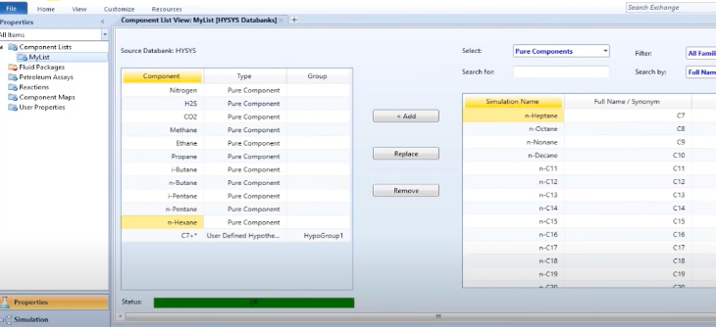
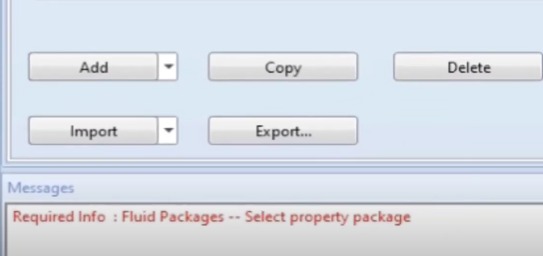
Example Given Data

Slide 26







Fluid Package & Property Package

Slide 27
How to Select property package
To choose the thermodynamic model in the HYSYS simulation process and create a virtual component, follow these steps:
1. Select Thermodynamic Model: After defining the virtual component, you need to select a thermodynamic model that accurately represents its behavior. Go to the "Simulation Basis" pane and click on the "Packages" tab. Here, you'll find a list of available thermodynamic models.
2. Evaluate Options: Review the available thermodynamic models and evaluate which one best suits your virtual component. The choice of thermodynamic model depends on factors such as the type of components involved, the phase behavior, and the accuracy required for your simulation.
3.Select Thermodynamic Model: Once you've decided on the appropriate thermodynamic model, right-click on it and select "Set as Active." This will set the selected thermodynamic model as the active one for your simulation case.

Slide 28
Methods assistant
When choosing a thermodynamic model in the simulation process to create a component, several factors must be taken into account to ensure accurate representation of the component's behavior. Some of the most important factors include:
1. Type of Component: Consider the type of component you are modeling, whether it's a pure substance, a mixture, or a complex chemical compound. Different thermodynamic models are designed to handle different types of components more effectively.
2. Phase Behavior: Evaluate the phase behavior of the component under different temperature and pressure conditions. Ensure that the selected thermodynamic model can accurately predict phase equilibrium, including vapor-liquid, liquid-liquid, and solid-liquid equilibria, if applicable.

Slide 29
3.Complexity of the System: Assess the complexity of the system in which the component is present. Some thermodynamic models are better suited for simple systems with ideal behavior, while others are more appropriate for complex systems with non-ideal behavior, phase changes, or chemical reactions.
4. Accuracy Requirements: Determine the level of accuracy required for your simulation. Some thermodynamic models provide more accurate predictions for specific properties or behaviors, such as vapor pressure, enthalpy, heat capacity, or compressibility. Choose a model that meets your accuracy requirements.
5.Experimental Data Availability: Consider the availability and reliability of experimental data for the component. Some thermodynamic models rely heavily on experimental data for parameterization and validation. If robust experimental data is available, you may prefer a model that is well-supported by empirical correlations.

Slide 30
Methods assistant
6. Applicability to Process Conditions: Ensure that the selected thermodynamic model is applicable to the temperature, pressure, and composition ranges encountered in your process. Some models may be more suitable for certain temperature or pressure regimes, while others may be more versatile.
7.Software Compatibility: Check the compatibility of the thermodynamic model with the simulation software you are using. Ensure that the model is implemented correctly within the software and that it provides reliable results.

Slide 31
Regarding the default "refrigeration gas" in HYSYS application, the choice of thermodynamic model for refrigeration gases typically depends on factors such as the specific refrigerant used, the operating conditions of the refrigeration system, and the desired level of accuracy. Commonly used thermodynamic models for refrigeration gases include the Peng-Robinson (PR) equation of state, the Soave-Redlich-Kwong (SRK) equation of state, and the Lee-Kesler-Plocker (LK) method. It's essential to select a model that accurately represents the behavior of the refrigeration gas under the given operating conditions to ensure reliable simulation results.

Slide 32







Property package for existing plant

Slide 33



Binary Coefficients

Slide 34





Binary Coefficients

Slide 35


Binary Coefficients

