Slide 1
Electronics and system components
Chapter 3. Motherboard

Slide 2
Presentation plan
1. Definition (morphology or support) of the motherboard
2. Motherboard components
2.1. Integrated (or embedded) elements
2.2. Chipset
2.3. Real Time Clock (RTC)
2.4. CMOS battery
2.5. BIOS
2.6. CPU support
2.7. Slots
2.8. Input-output connectors
3. Motherboard Features
3.1. Features
3.2. Mainboard footprint (or form factor)
3.3. Card formats (some examples)
3.4. Manufacturers

Slide 3
1. Definition (morphology or support) of the motherboard
Reminder (see 4. Composition of a PC in chapter 2)
Motherboard support = (formed by)
Printed circuit
+
connectors (connection ports) to attach Microprocessor and RAM
+
connectors (connection ports) allow to connect (using a connection cable) hard drive and the reader CD/DVD drive (Compact Disc/ Digital Versatile Disc) and expansion cards and peripherals and power supply

Slide 4
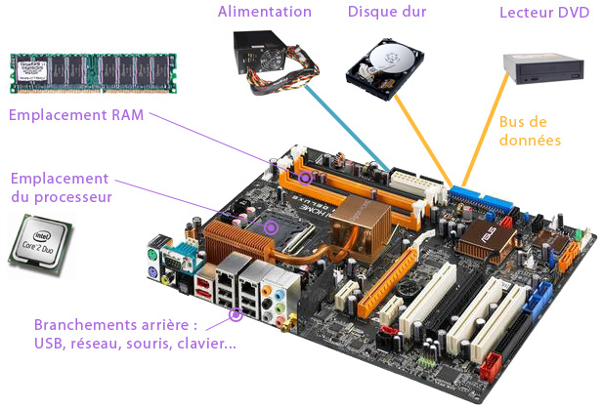
Motherboard support
(following)

Slide 5
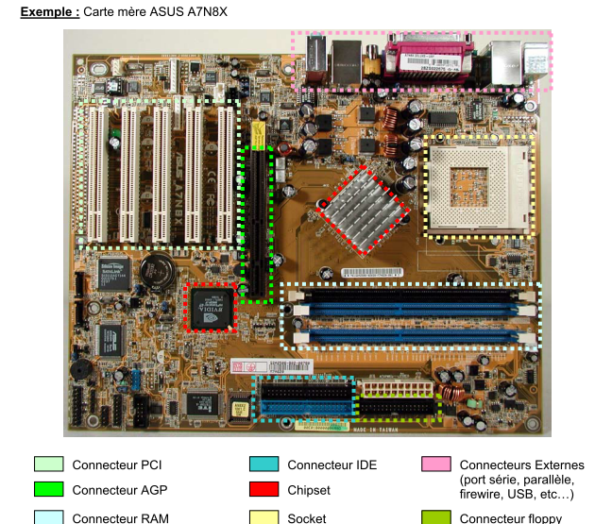
Motherboard support
(following)

Slide 6
1. Motherboard support (following)
Example: ASUS A7N8X motherboard (following)
PCI : Peripheral Component Interconnect
AGP : Accelerated Graphics Port
IDE connector : Integrated Drive Electronics (IDE) is a standard connection interface used in computer to transfer data between motherboard of a computer or server to mass memory media: hard disk, DVD and CD-ROM.
fireware : In a computer system, firmware (or microprogram, microcode, internal software or embedded software) is a program integrated into computer hardware (computer, photocopier, hard drive, router, digital camera, etc.) so that it can work.

Slide 7
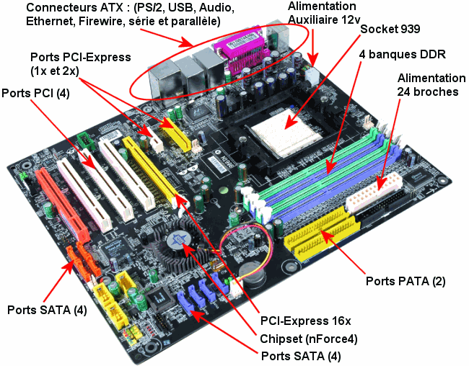
1. Motherboard support (following)

Slide 8
1. Motherboard support (following) Example: ASUS A7N8X motherboard (following)
Connecteurs ATX : ?
PCI-Express : ?
PS/2: ?
Ethernet : Port RJ45 ?
Port SATA : "Serial Advanced Technology Attachement", is a connector essentially used for connecting mass
memory (a hard drive for example).
The SATA connector allows "hot" plugging (device on). In its first version, the data rate reaches 150MB/s.
Alimentation auxiliaire 12V : ?
Port PATA : The Parallel ATA standard describes a connection interface for mass memories.
DDR SDRAM : Double Data Rate Synchronous Dynamic Random Access Memory is a type of integrated circuit memory used in computers since 2000
Chipset (nForce4) :
Socket 939 :

Slide 9
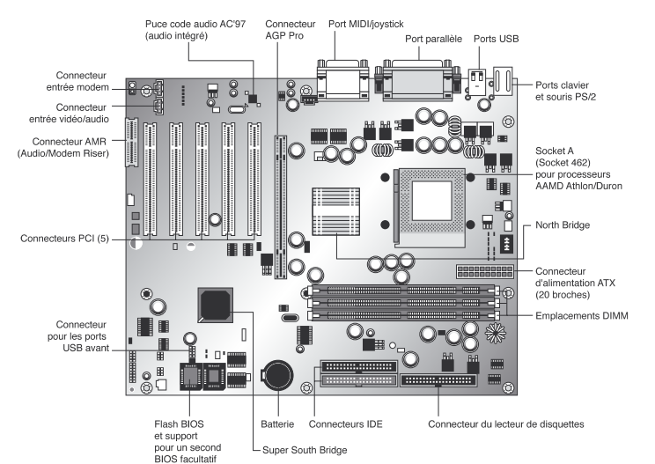
Motherboard support (exercice 1)
Could you identify the different connectors on this motherboard ?

Slide 10
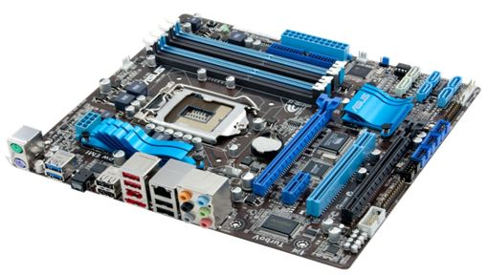
1. Motherboard support (exercice 2)
Could you identify the different connectors on this motherboard ?

Slide 11
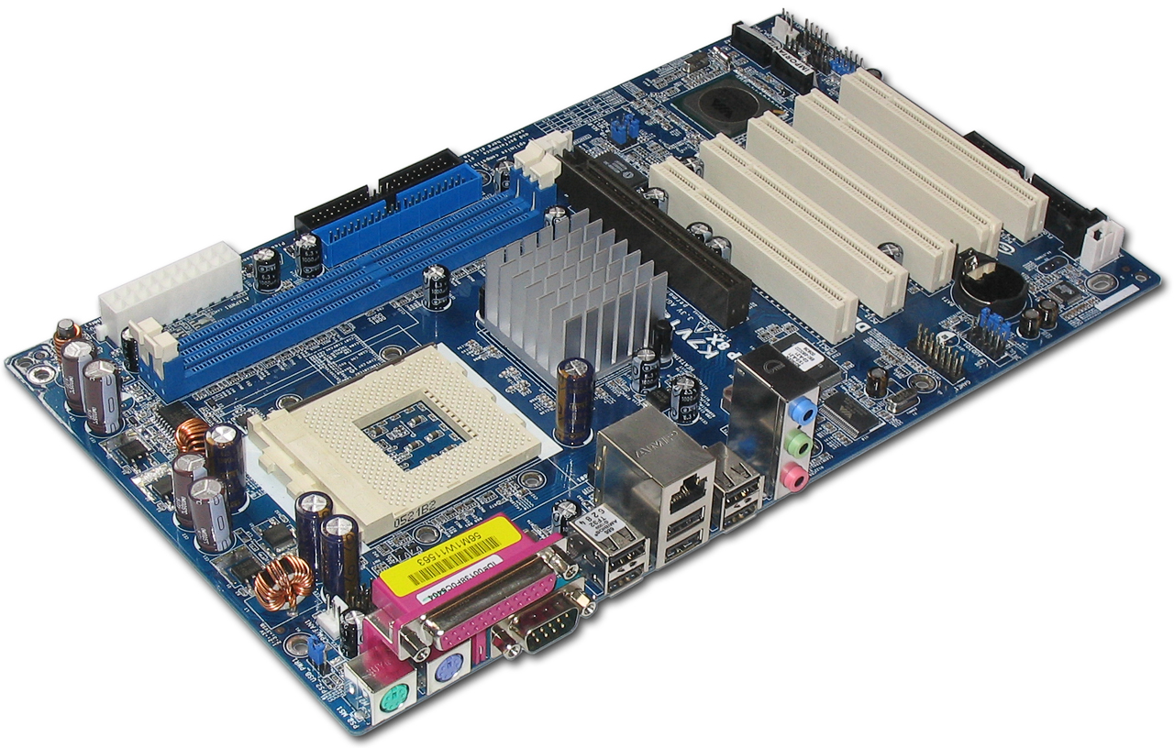
1. Motherboard support (exercice 3)
Could you identify the different connectors on this motherboard ?

Slide 12
2. Motherboard components
2.1. Integrated (or embedded) elements
Integrated (or embedded) elements on the printed circuit of a motherboard
  Chipset (a set of chips that manages the flow of data between the
  microprocessor and other components on the motherboard)
  Clock
  CMOS
  ROM (BIOS)
  System bus (See 5. General diagram of how a computer works in Chapter 2)
  CPU support
  Slots
  Input-output connectors

Slide 13
2. Motherboard components
2.1. Integrated (or embedded) elements (following)
Elements that can be integrated (or embedded) in printed circuit of
a motherboard
  Graphic card
  Sound card
  Network card

Slide 14
2. Motherboard components
2.2. Chipset
Chipset (chip = puce + set = ensemble) ➔ Chipset = Ensemble de puces
The chipset coordinates data exchange (manages communications) between the
processor and the computer components
Chipset récente = Ensemble de puces + puce graphique + puce audio ➔
No need to add (install) a graphics card and a sound card
Chipset Manufacturers
  Intel
  AMD
  SIS (Silicon Integrated Systems)
  Azus
  VIA

Slide 15
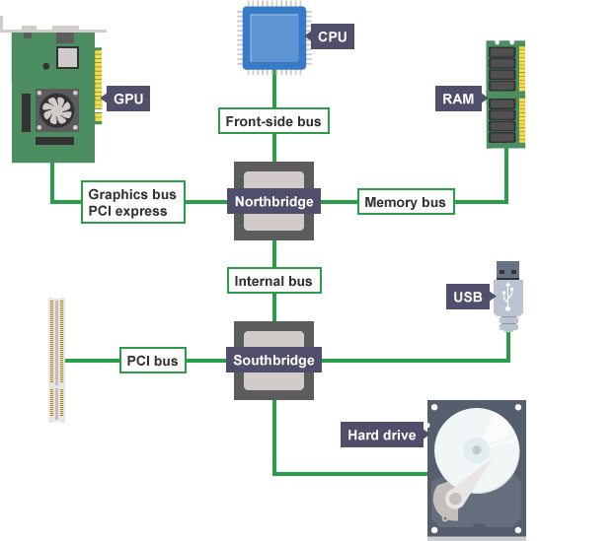
2. Les composants de la carte mère
2.2. Chipset (following) : Typical motherboard diagram
Architecture Chipset North-bridge/South-bridge

Slide 16
2. Motherboard components
2.2. Chipset (following)
RAM and graphics card are fast (quick access for reading and writing) ➔ Data
exchanges between microprocessor and {RAM + graphics card} require large
bandwidth.
Slow computer components
  Hard disk (hard disk drive)
  CD-ROM (compact disc – read only memory) or CD/DVD drive
  Memory card reader
  USB (Universal Serial Bus)
  Expansion cards and peripherals

Slide 17
2. Motherboard components
2.2. Chipset (following)
  Northbridge ➔ North Bridge coordinates data exchanges (manages communications or interface) between Microprocessor and fast components of the computer
  Southbridge ➔ South bridge coordinates data exchanges (manages communications or interface) between the microprocessor and slow computer of components
  North bridge/South bridge connection
    Intel ➔ Intel Hub Architecture (IHA)
      533 Mo/s.
    Nvidia (in collaboration with AMD) ➔ HyperTransport
      800 Mo/s.

Slide 18
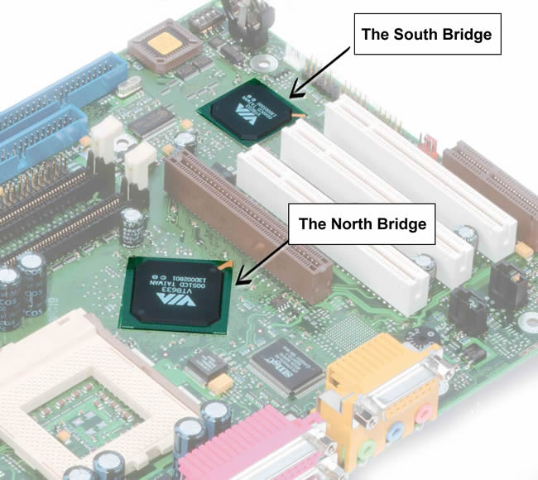
2. Motherboard components
2.2. Chipset (following)
Chipset North-bridge/South-bridge

Slide 19
2. Motherboard components
2.2. Real Time Clock (RTC)
Most physical quantities that can be measured quantitatively occur in nature in analog form (deterministic form)
Analog quantity ➔ sampling (a series of discrete values) ➔ coding ➔ numerical quantity (a numerical code i.e. a series of 1 and 0)
Two voltage levels (HIGH and LOW) :
Binary system (0, 1) : 0 and 1 are called bits (contraction of binary digit)
➔ (HIGH represents 1 & LOW represents 0) (coding principle)

Slide 20
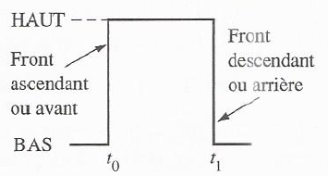
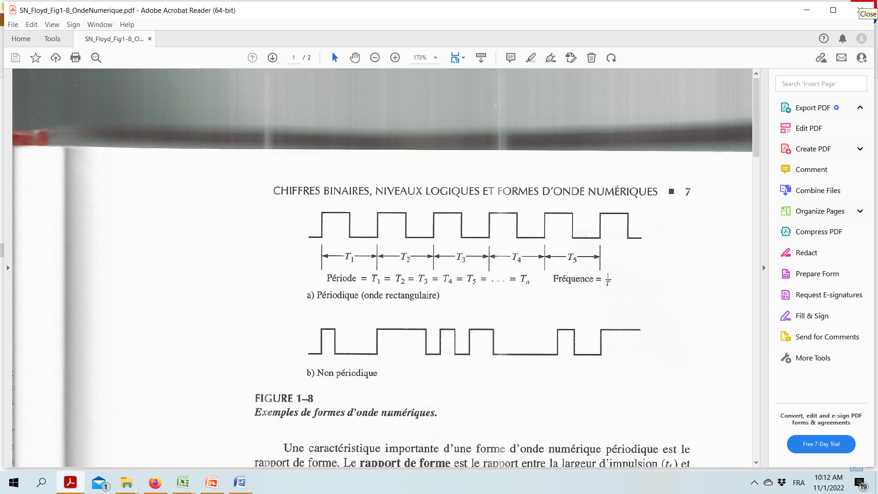
2. Motherboard components
2.2. Real Time Clock (RTC) (following)
Pulse
Digital wave (pulse wave) = a series of pulses (pulse trains)
HIGH represents 1 and LOW represents 0 (this is a coding principle)
An impulse wave contains binary information (succession of bits)

Slide 21
2. Motherboard components
2.2. Real Time Clock (RTC) (following)
A periodic impulse wave ➔ Clock signal
Each pulse wave created by a circuit (its shape) depends on (is synchronized from) the clock signal
Example ➔ Signals produced by an electronic system (or computer system) ensuring digital electronic functions are synchronized from a clock signal

Slide 22
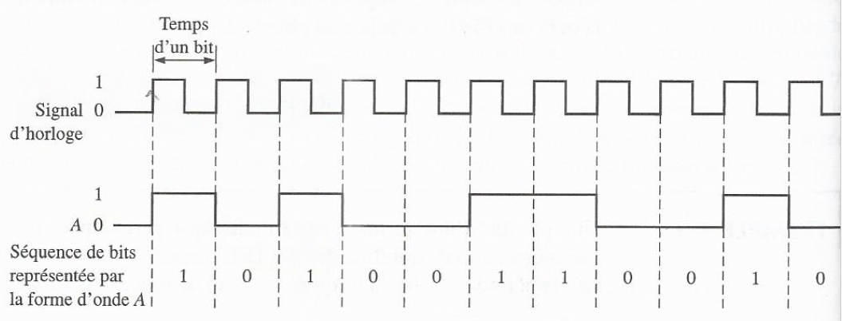
2. Motherboard components
2.2. Real Time Clock (RTC) (following)

Slide 23
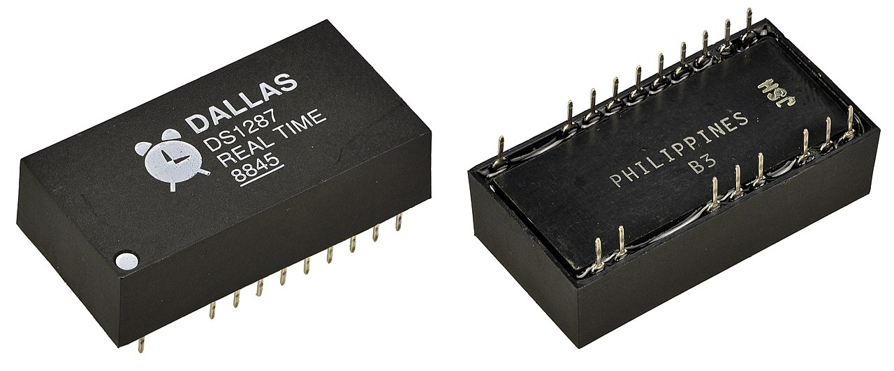
2. Motherboard components
2.2. Real Time Clock (RTC) (following)
Clock = crystal that vibrates + … ➔ (transmit or provide) a clock signal
Clock frequency (number of crystal vibrations per second = number of pulses per second or number of pulses per second in MHz)
Example of a Real Time Clock
The amount of processed information is proportional to the clock frequency.

Slide 24
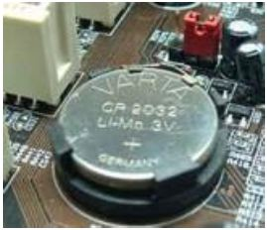
2. Motherboard components
2.4. CMOS battery
CMOS (Complementary Metal-Oxyde Semiconductor) ➔ (CMOS based circuit)
CMOS based circuit is capable to memorize some important parameters about system
  Clock
  Date
CMOS battery

Slide 25
2. Motherboard components
2.5. BIOS
BIOS (Basic Input/Output System) (This is a basic program serving as an interface between the operating system and the motherboard)
The BIOS is stored in a ROM (Read Only Memory)
The BIOS uses the data contained in CMOS to know system hardware configuration
BIOS setup (configuration du BIOS) (interface used to configure BIOS)
(a common way to enter BIOS setup is to press a specific key during the startup process, before the Windows logo appears)(The key may differ depending on your computer model).

Slide 26
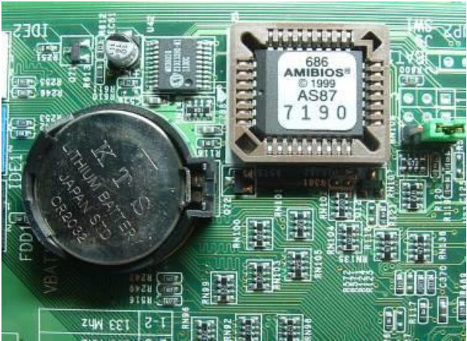
2. Motherboard components
2.5. BIOS (following)
BIOS

Slide 27
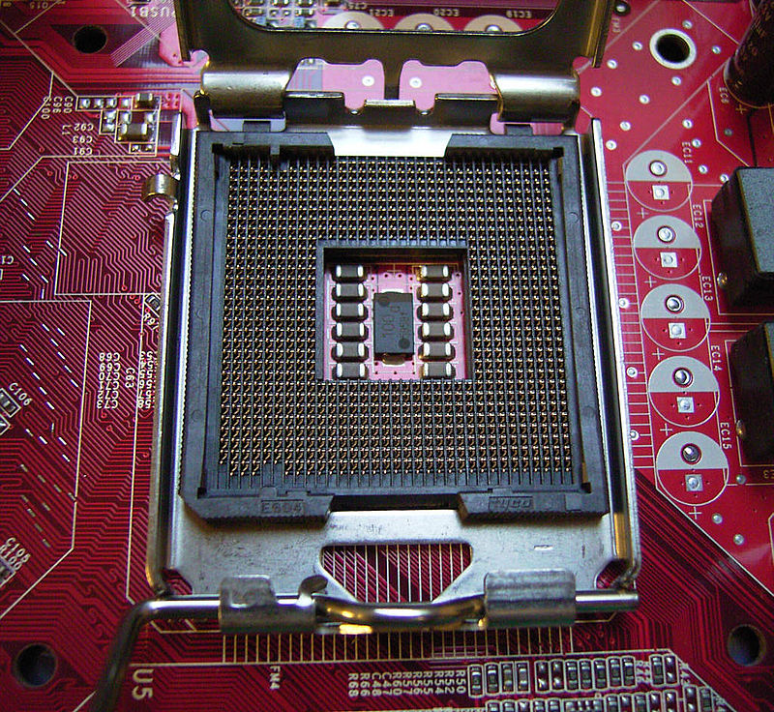
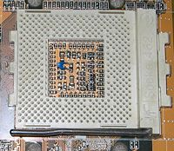
2. Motherboard components (following)
2.6. Microprocessor support
Processor support (location on the motherboard for integrating the processor)
Multiprocessor motherboard ➔ multiple support
Processor support
  Slot (rectangular connector allows the processor to be inserted vertically)
  Socket (square connector allows the processor to be directly plugged in)
Socket
Socket

Slide 28
2. Motherboard components
2.6. Microprocessor support (following)
A microprocessor can have several hundred pins which are used for its connection (its attachment) ➔ It is necessary to make a connection carefully to avoid bending any of its pins ➔ What is the solution ?
ZIF (Zero Insertion Force) (a support with a small lever which, by raising it, allows the insertion of the processor without any pressure and by lowering it keeps the processor on its support or in its location)

Slide 29
2. Motherboard components
2.6. Microprocessor support (following)
A processor heats up during its enormous work (heat production by Joule effect) ➔ Circuits destruction if overheating ➔ What is the solution ?
Heat sink (cooler or radiator) on the processor (It is made using a metal with good thermal conduction like copper Cu and aluminum Al)➔ Increase heat exchange surface of the microprocessor ➔ Maximum heat dissipation ➔ Microprocessor cooling➔ Microprocessor circuits protection if overheating

Slide 30
2. Motherboard components
2.7. Slots (Expansion connectors)
  PCI connector (Peripheral Component Interconnect) ➔ connecting PCI cards
  AGP connector (Accelerated Graphics Port)➔ Graphics card connector
  (allows a quick information exchange)
  PCI Express connector (Peripheral Component Interconnect Express)
  (bus architecture faster than PCI and AGP buses)
  AMR connector (Audio Modem Riser) ➔ Inserting mini audio and modem
  cards onto the motherboard

Slide 31
2. Motherboard components
2.8. Input-output connectors
2.8.1. Serial and parallel
Serial port ➔ Old devices
Parallel port➔ Old printers
2.8.2. USB
USB Port (Universal Serial Bus Port)
  USB 1.1 ➔ bas debit
  USB 2.0 ➔ hight debit
  USB 3.0 & USB 4.0 ➔ Super Speed
USB Ports ➔ Recent Devices
2.8.3. Hard Disk
SATA Port (Serial Advanced Technology Attachement) is a connector essentially used for
connecting mass memory (a hard drive for example).
The SATA connector allows "hot" plugging (device on)(In its first version, the data rate reaches
150MB/s)
Port eSATA (external Serial Advanced Technology Attachement) (faster)

Slide 32
2. Motherboard components
2.8. Input-output connectors (following)
2.8.4. Screen
VGA connector (Video Graphics Array) on graphics card ➔ analog connection of
Screen
HDMI connector (High-Definition Multimedia Interface) ➔ digital connection of
High Definition screen
DVI connector (Digital Visual Interface) ➔ digital video connection
2.8.5. Keyboard and mouse
PS/2 Port (green) ➔ old mouse
Port PS/2 (purple)➔ old keyboard

Slide 33
2. Motherboard components
2.8. Input-output connectors (following)
2.8.6. Audio
Audio connector on sound card
  Audio output (green)➔ Headphone, baffle
  Audio input (pink)➔ Microphone
2.8.7. Network
RJ45 port (Local Area Network or Ethernet port) on Network card ➔
Modem and/or network

Slide 34
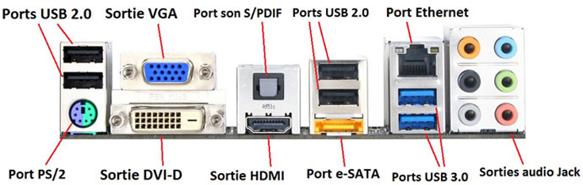
2. Motherboard components
2.8. Input-output connectors (following)
2.8.8. Connector grouping
For a desktop, connectors are grouped on the rear side of the central unit

Slide 35
3. Motherboard Features
3.1. Features
  Size factor
  Chipset
  Processeur support
  Input-output connectors

Slide 36
3. Motherboard Features
3.2. Size factor
Size factor
  Motherboard geometry
  Dimensions
  Layout (organization)
  Electrical Specifications

Slide 37
3. Motherboard Features
3.3. Card formats (some examples)
3.3.1. ATX
ATX (Advanced Technology Extended)
ATX format advantages
  Connector layout makes it easier to connect peripherals
  Parallel orientation of motherboard components ➔ Easy heat dissipation

Slide 38
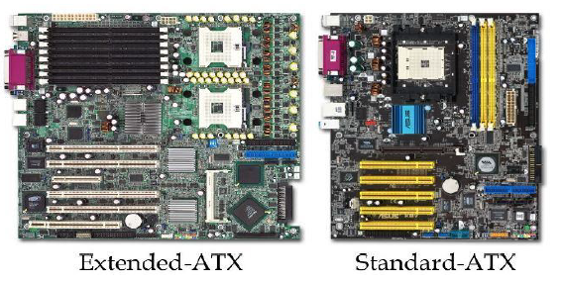
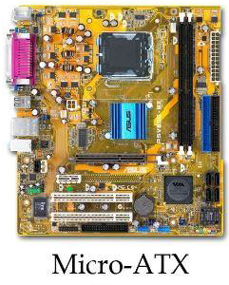
3. Motherboard Features
3.3. Card formats (some examples)
3.3.1. ATX (following)
ATX standard
  Dimensions 305 mm X 244 mm
  AGP connectors
  6 PCI connectors
Micro-ATX
  Dimensions 244 mm X 244 mm
  AGP connectors
  3 PCI connectors
Mini-ATX (compact format alternative to micro-ATX format)
  Dimensions 284 mm X 208 mm
  AGP connectors
  6 PCI connectors

Slide 39
3. Motherboard Features
3.3. Card formats (some examples)
3.3.2. BTX (Balanced Technology eXtended) (Intel)
BTX format advantages
  Organization of components ➔ Optimized air circulation ➔ Optimized
  component cooling
  Microprocessor positioned near the ventilation inlets ➔ Optimized
  microprocessor cooling
BTX standard
  325mm X 267mm
Micro-BTX
  264mm X 267mm
Pico-BTX
  203mm X 267mm

Slide 40
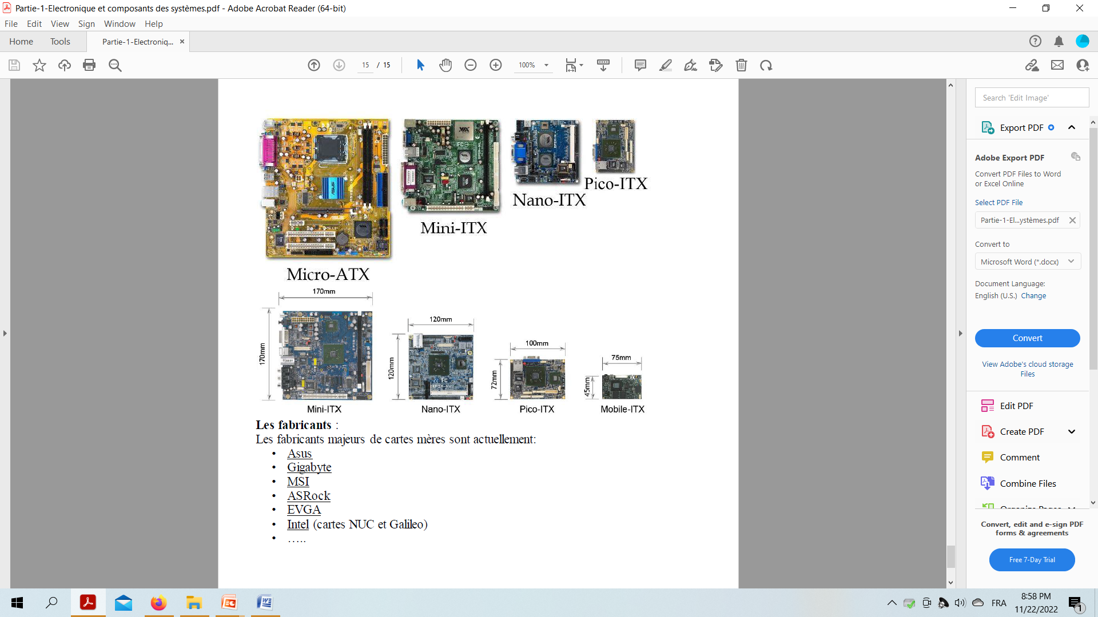
3. Motherboard Features
3.3. Card formats (some examples)
3.3.3. ITX (Information Technology eXtented)
Mini-ITX
  170mm X 170mm
  PCI Connector
Nano-ITX
  120mm X 120mm
  PCI Connector
Pico-ITX
  100mm X 72mm
Mobile-ITX
  75mm X 45mm

Slide 41
3. Motherboard Features
3.4. Manufacturers (the main ones)
ASUS
Gigabyte
MSI
ASRock
EVGA
Intel (NUC and Galileo cards)

