Slide 1
Electronics and system components
Chapter 1. Electronic system versus computer system
(definitions and generalities)

Slide 2
Presentation plan
1. Electronics
1.1. Definition of electronics
1.2. Electronics applications
1.3. From electronic component to electronic system
1.3.1. Electronic components
1.3.2. Circuit (printed and integrated)
1.3.3. Analog electronic functions
1.3.4. Digital electronic functions
1.3.5. Electronic system
2. Computer science (Informatique)
2.1. Definition of computer science
2.2. Computer system

Slide 3
Electronics
1.1. Definition of electronics
Maxwell's laws of electromagnetism
Kirchhoff's laws (law of meshes and law of knots)
Electronics (or systems science) (Electronics is a science that deals with
electrical signals capable of forming and providing useful information for
humans)

Slide 4
Electronics (following)
1.2. Electronics applications
Telecommunication
  Telephony
  Television
Detection systems
  Radar
  Sonar
Data processing

Slide 5
Electronics (following)
1.3. From electronic component to electronic system : 1.3.1. Electronic components
Electronic components
  Material and geometric structure ➔ Particular effect on the electrical signal capable to ensure an electronic function
  Material and geometric structure ➔ In the same category, there are types different in their electrical characteristics
Electronic components (exemples)
  Resistor R
  Capacitor C
  Inductance L
  Generator (cells and batteries)
  Diode
  Bipolar transistor and field effect transistor

Slide 6
1.3. From electronic component to electronic system (following)
1.3.2. Circuit (printed and integrated)
Electronic Components association ➔ Circuit capable to ensure one or more electronic functions (analog or digital)
Compact assembly of electronic components (assembly on the same surface) ➔ Integrated circuit
An integrated circuit is also capable to ensure one or more electronic functions (analog (operational amplifier, Analog to Digital Converter or Digital to Analog Converter) or digital)

Slide 7
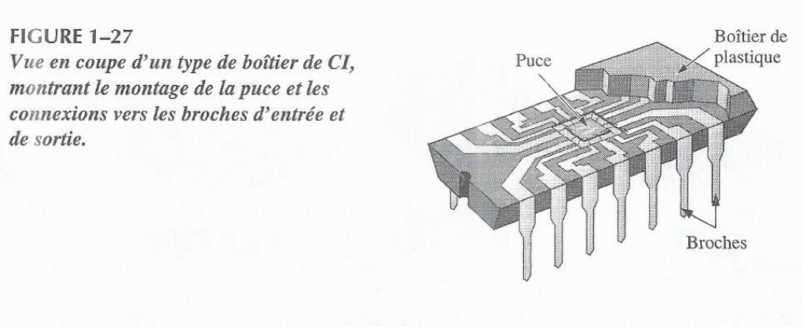
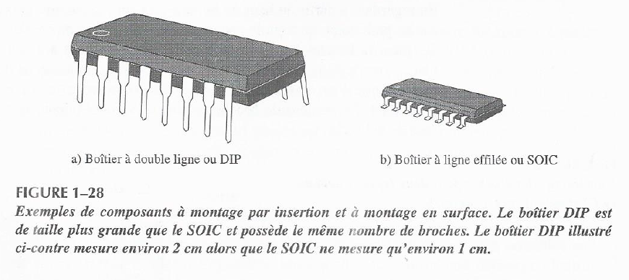
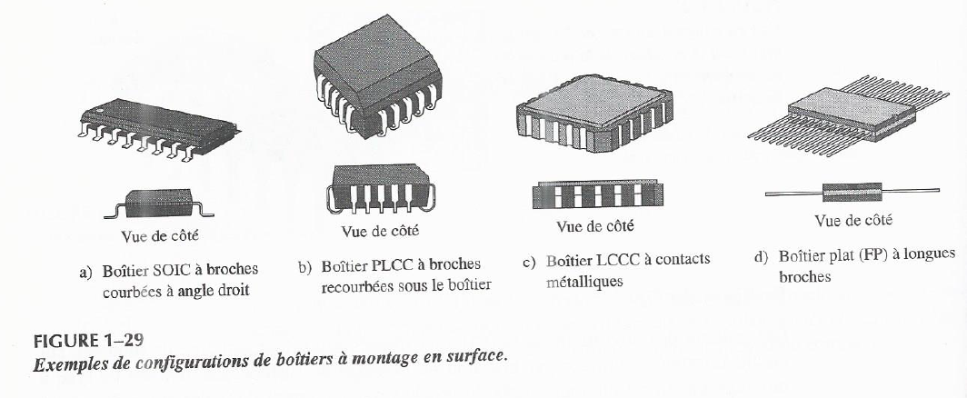
1.3.2. Circuit (printed and integrated) (following)
Integrated circuit

Slide 8
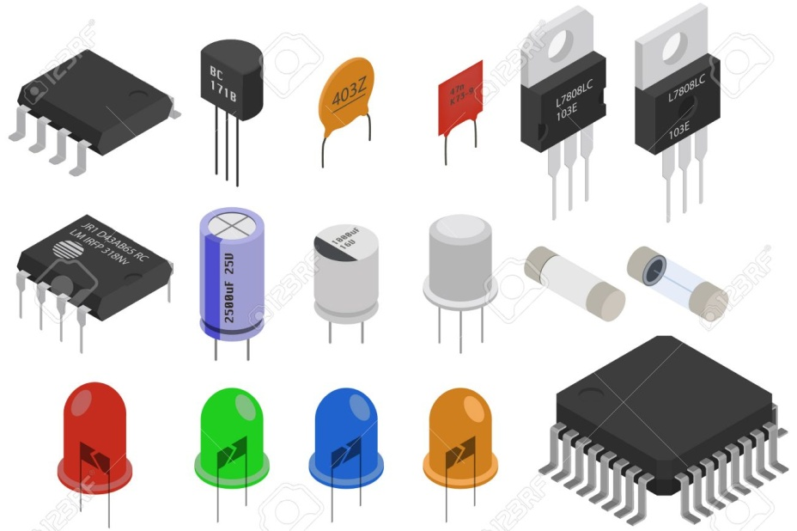
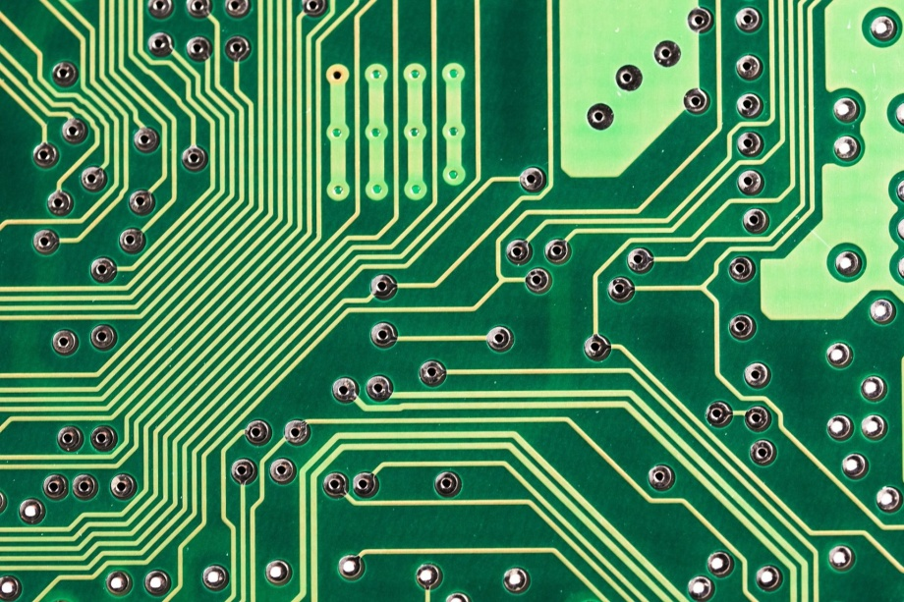
1.3.2. Circuit (printed and integrated) (following)
Printed circuit (It is used to hold and connect the components)
Components and integrated circuits
Printed circuit board

Slide 9
1.3. From electronic component to electronic system (following)
1.3.3. Analog electronic functions
Analog electronic functions
  Signal recovery ➔ DC voltage (and voltage stabilization)
  Signal amplification or differential amplification
  Signal integration
  Signal derivation
  Signals summation and subtraction
  Signal Filtering based on frequency to extract the useful signal

Slide 10
1.3.4. Digital electronic functions (following)
Digital electronic functions
  Basic logic operations processing one information (buffer, inverter) or two informations (AND gate, NAND gate, NOR gate, etc.)
  Basic logic functions
    Comparison function
    Arithmetic function
      Adder
      Multiplier
    Code conversion function
    Coding function
    Decoding function
    Data selection function
    Multiplexer
    Demultiplexer

Slide 11
1.3.4. Digital electronic functions (following)
  Storage function
    Flip-flops
    Register
    Semiconductor memories
    Magnetic memories
  Counting function

Slide 12
1.3. Digital electronic functions (following)
1.3.5. Electronic system
A component or circuit can be considered as an electronic system
Instructions in software ➔ An electronic system ➔ (performs) Analog and digital electronic functions
The instructions provided by the input devices witch form the human-machine interface ➔ An electronic system ➔ (performs) Analog and digital electronic functions

Slide 13
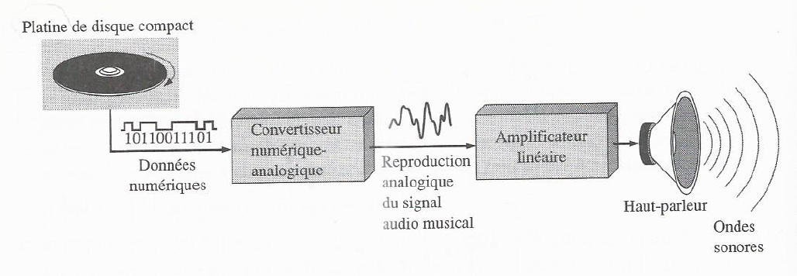
1.3. Digital electronic functions (following)
1.3.5. Electronic system
Compact Disk
Speaker
digital data
Digital to Analog Converter
linear amplifier
Principle of compact disc player

Slide 14
2. Computer science (Informatique)
2.1. Definition of computer science
Information processing, i.e. application of analog and digital electronic functions
to information (signals carrying and forming information)
Information (post-processing or pre-processing) can take several forms
  Texts (letters and numbers)
  Pictures
  Sounds
  Videos
Automatic processing (information processing carried out by an electronic system without the intervention of a human operator) ➔ automated electronic system

Slide 15
2.1. Definition of computer science (following)
Automatic processing (information processing carried out by an electronic system
without the intervention of a human operator) ➔ automated electronic system
Automated digital electronic system
  Electronics
  Program / Software

Slide 16
2.1. Definition of computer science (following)
Computer (basically, computer is an exemple of an advanced automated and digital electronic system)
Information + Automatique (Philippe DREYFUS en 1962)
➔ Informatique (= Traitement automatique de l’information)
Computer science (the science which studies the digital and automatic information processing using a computer)

Slide 17
2.2. Computer system
Softwares (ou programmes) + Hardware ➔ An automated and digital electronic system capable to execute an application ➔ Computer system
Conclusion
A computer is an example of an advanced automated digital electronic system capable to execute a lot of applications (programs)

