Slide 1

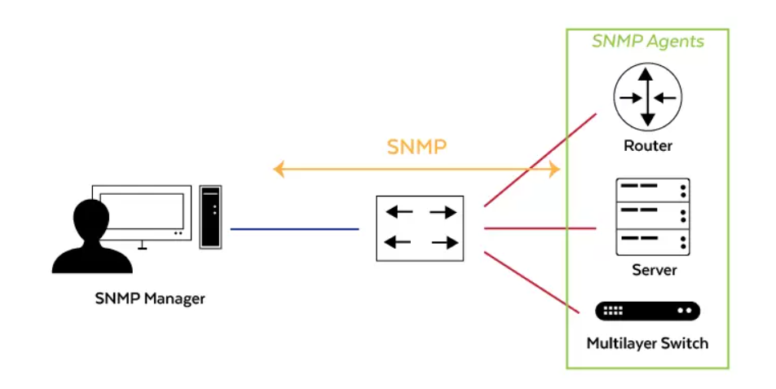
SNMP
REPUBLIQUE ALGERIENNE DEMOCRATIQUE ET POPULAIRE
MINISTERE DE L’ENSEIGNEMENT SUPERIEURE ET DE LA RECHERCHE SIENTIFIQUE
Simple Network Management Protocol
Presented by :
Khemici dalal
Tamen hibet ellah
Group : 01
Moderated by :
M.Bencheikh Lehocine

Slide 2


WORK PLAN
Introduction
1
SNMP overview
Conclusion
2
7
SNMP operations
SNMP versions
3
6
5
SNMP messages
4
SNMP & ports

Slide 3
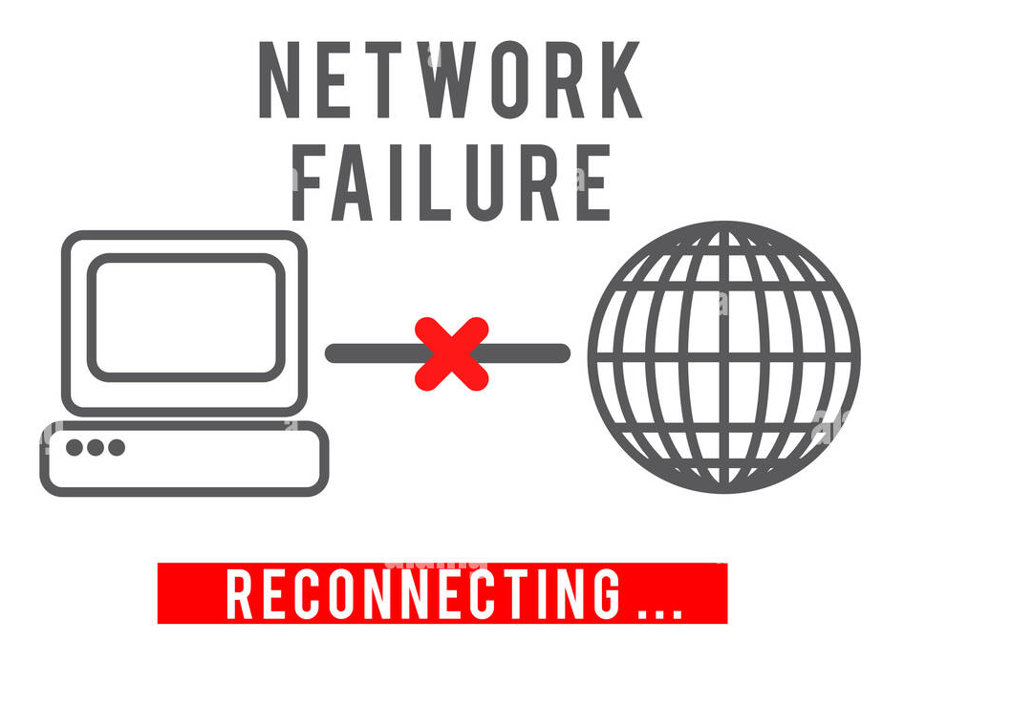
Introduction
Imagine you have around 100 routers and switches across your network and all the links that go with them, everything is running well but then your network starts to slow down. It's up to you to figure out which of your 100 routers, switches or links is the problem. What tools will you use to solve this?

Slide 4

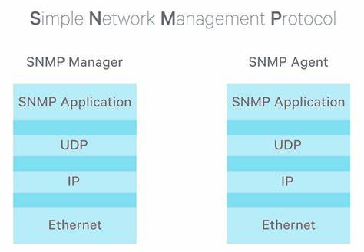
SNMP overview
It's an application-layer protocol(tool) that enables you to monitor and manage the health of the network. You can find the problem or you could even see the warning signs before you even have a problem.
SNMP can be used to monitor status of devices, make configuration changes, etc.

Slide 5
There are two main types of devices in SNMP:
these are the devices being managed by SNMP.
Network management station (NMS)
the device/devices managing the managed devices
Managed devices (Agent)
for example: Routers and switches.
this is the SNMP "server"

Slide 6

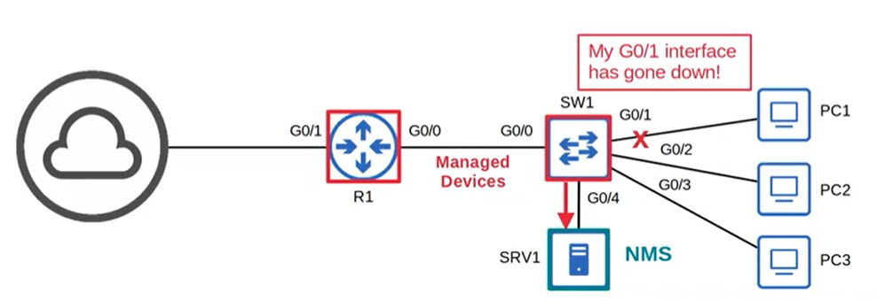
SNMP Operations
There are 3 main ways SNMP can be used to help manage a network:
1-Managed devices can notify the NMS of events

Slide 7
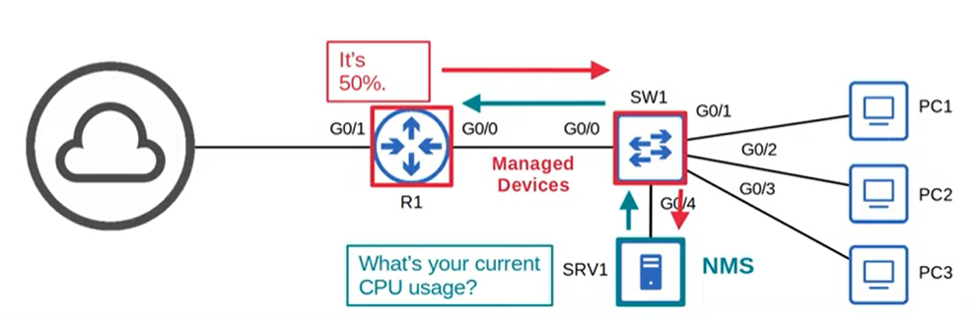
2-The NMS can ask the managed devices for information about their current status

Slide 8
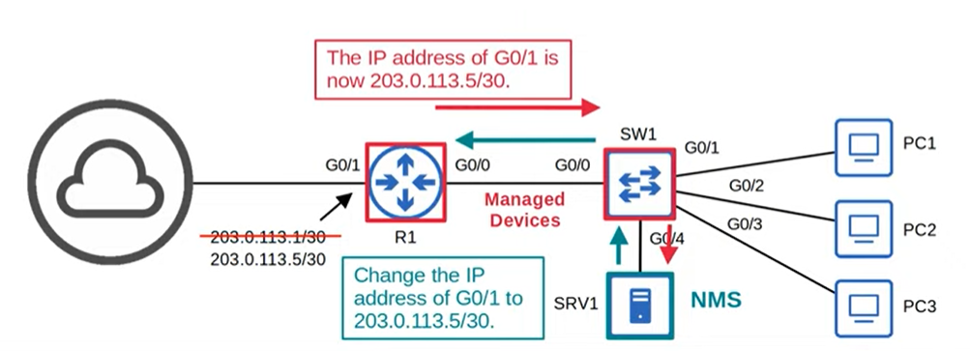
3-The NMS can tell the managed devices to change their configuration, for example: change hostname, IP address..

Slide 9

SNMP messages
Message class | Read | Write | Notification | Response
Description | Messages sent by the NMS to read information from the managed devices. | Messages sent by the NMS to change information on the managed devices. | Messages sent by the managed devices to alert the NMS of a particular event | Messages sent in response to previous message/request
Messages | Get GetNext GetBulk | Set | Trap Inform | Response
Example | What's your current CPU usage? | Change an IP address | Interface going down

Slide 10
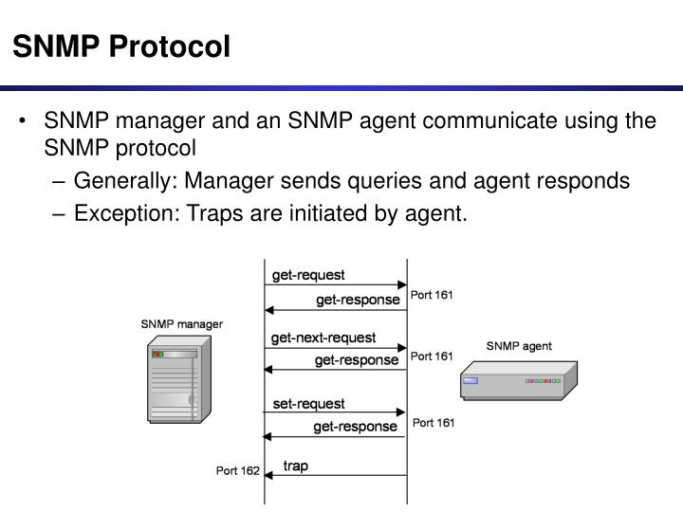
SNMP & ports
SNMP uses User Datagram Protocol (UDP) as the transport mechanism for SNMP messages.
SNMP uses two well-known ports:
Agents sending messages up to manager: Port 162
Managers sending messages down to agents :Port 161

Slide 11

SNMP versions
SNMPv1: the original version of SNMP
SNMPv2c : Allows the NMS to retrieve large amounts of information in single request GetBulk
SNMPv3: a much more secure version that supports strong encryption and authentication.

Slide 12

Conclusion
In conclusion, the Simple Network Management Protocol (SNMP) was developed as a powerful tool for controlling and monitoring the status of network devices. With its ability to enable network administrators to manage network performance, find and solve network problems, and plan for network growth, SNMP has become an essential component in the management of modern computer networks, and it will likely continue to play a critical role in ensuring the reliability and effectiveness of networks for years to come.

Slide 13
references
https://www.whatsupgold.com/fr/blog/comment-utiliser-snmp-pour-surveiller-les-peripheriques-reseau
https://infocenter.nokia.com/public/7750SR222R1A/index.jsp?topic=%2Fcom.nokia.System_Mgmt_Guide%2Fsnmp_protocol_o-ai9exj5ydq.html
https://fr.wikipedia.org/wiki/Simple_Network_Management_Protocol#:~:text=Simple%20Network%20Management%20Protocol%20(abr%C3%A9g%C3%A9,r%C3%A9seaux%20et%20mat%C3%A9riels%20%C3%A0%20distance
https://www.snmpcenter.com/snmp-ports-using-udp-ports-161162/

