Slide 1

PEOPLE'S DEMOCRATIC REPUBLIC OF ALGERIA
MINISTRY OF HIGHER EDUCATION AND SCIENTIFIC RESEARCH
Mila Abdelhafid Boussouf University Centre
Speciality: Master 1 ICST
MPLS
Multi-Protocol Label Switching
Interconnection and Network Management
Prepared By:
HOUSSINE Benmessiaoud Dr. M.Benchikhlhoucine
Sekhri Haroun
2022-2023

Slide 2
Definition
What Is MPLS Used For ?
Benefits of MPLS
Drawbacks of MPLS
MPLS Label
Forwarding in MPLS
MPLS vs.
Conclusion
References
Summary

Slide 3
Definition
MPLS or Multi-Protocol Label Switching is a network technology that has powered enterprise networks for over two decades. Unlike other network protocols that route traffic based on source and destination address, MPLS routes traffic based on predetermined “labels”. Businesses use MPLS to connect remote branch offices that require access to data or applications that reside in the organization's data center or company head office.
There’s been some confusion about whether MPLS is a Layer 2 or Layer 3 service. But MPLS doesn’t fit neatly into the OSI seven-layer hierarchy. But if we want to classify it, we can tell it is a Layer 2.5, meaning it falls between Layer 2 (Data Link) and Layer 3 (Network) of the OSI seven-layer.

Slide 4
Definition
Layer 2, or the Data Link Layer, carries IP packets over simple LANs or point-to-point WANs. Layer 3, or the Network Layer, uses internet-wide addressing and routing using IP protocols. MPLS sits in between these two layers, with additional features for data transport across the network.
MPLS works by labeling data packets with a short label that is used to identify the path that the data should take. This allows for the data to be routed quickly and efficiently, and it also provides a high level of security by allowing for the creation of private networks.

Slide 5
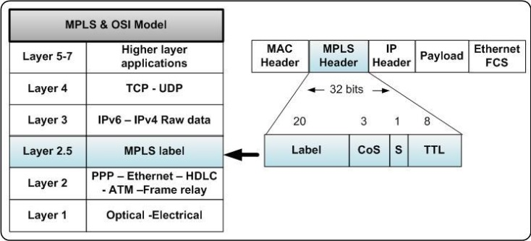
Definition

Slide 6
What Is MPLS Used For ?
MPLS works by assigning a label to each data packet that enters the network. The label is used to identify the packet and direct it to its destination through a series of pre-determined routes. This allows for faster and more efficient routing of data packets, as well as the ability to prioritize traffic and optimize network performance.
MPLS provides enhanced security features by allowing for the creation of virtual private networks (VPNs), which enable secure communication between geographically dispersed locations. Additionally, It can be used to support quality of service (QoS) guarantees, which ensure that high-priority traffic is given priority over lower-priority traffic.

Slide 7
Benefits of MPLS
MPLS is a highly efficient protocol that allows for data to be routed quickly and securely. It is also very reliable, as it allows for the creation of private networks that are not affected by external traffic or congestion, it does not provide encryption, but it’s a virtual private network and, as such, is partitioned off from the public internet. It also allows for Quality of Service (QoS) to be applied to data packets.
MPLS also provides a high level of scalability, as it can be used to connect different networks of any size. This makes it a great choice for large organizations that need to securely connect multiple locations.

Slide 8
Drawbacks of MPLS
MPLS can be expensive to implement, as it requires specialized hardware and software. Additionally, it can be difficult to troubleshoot and diagnose network issues, as the labels used to identify data packets may not be visible to the users.
MPLS also requires a high level of technical expertise to configure and maintain, and it is not suitable for all types of networks, that means it’s not as flexible as other routing protocols, making it difficult to adapt to changing network conditions. This can lead to decreased performance and reliability.

Slide 9
MPLS Label
Important terms needs to know:
Terms | Description
Forwarding Equivalence Class (FEC) | A collection of packets with the same characteristics. Packets of the same FEC are forwarded in the same way on an MPLS network. FECs can be identified by the source address, destination address, source port, destination port, and VPN.
Provider Edge (PE) | Router at edge of MPLS network that add or remove label from IP packet.
Customer Edge (CE) | Router at edge of customer network that send or receive IP packet from PE.
Label Switch Router (LSR) | Routers used in MPLS network that can understand labels.
Ingress LSR | LSR routers that receive IP packet from CE Routers and add MPLS header.
Intermediate LSR | LSR routers that swap label in MPLS header and assigned for forwarding labeled IP packet.
Egress LSR | LSR routers that send IP packet to CE routers and removes MPLS header.
Push, Pop and Swap | Action of addition, removal and swapping of labels by LSR respectively.

Slide 10
MPLS Label
A label is a short, fixed-length (4 bytes) identifier that is only locally significant. A label identifies an FEC to which a packet belongs. In some cases, such as load balancing, a FEC can be mapped to multiple incoming labels. Each label, however, represents only one FEC on a device.
The MPLS Header is 32 bit long and is divided into four parts. Compared with an IP packet, an MPLS packet has the additional 4-byte. The MPLS label is between the link layer header and the network layer header, and allows use of any link layer protocol. Next Figure shows position of an MPLS label and fields in the MPLS label.

Slide 11
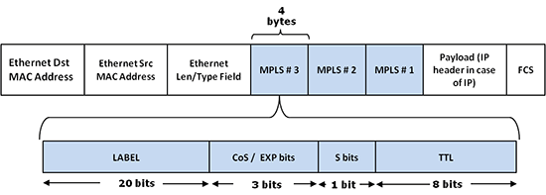
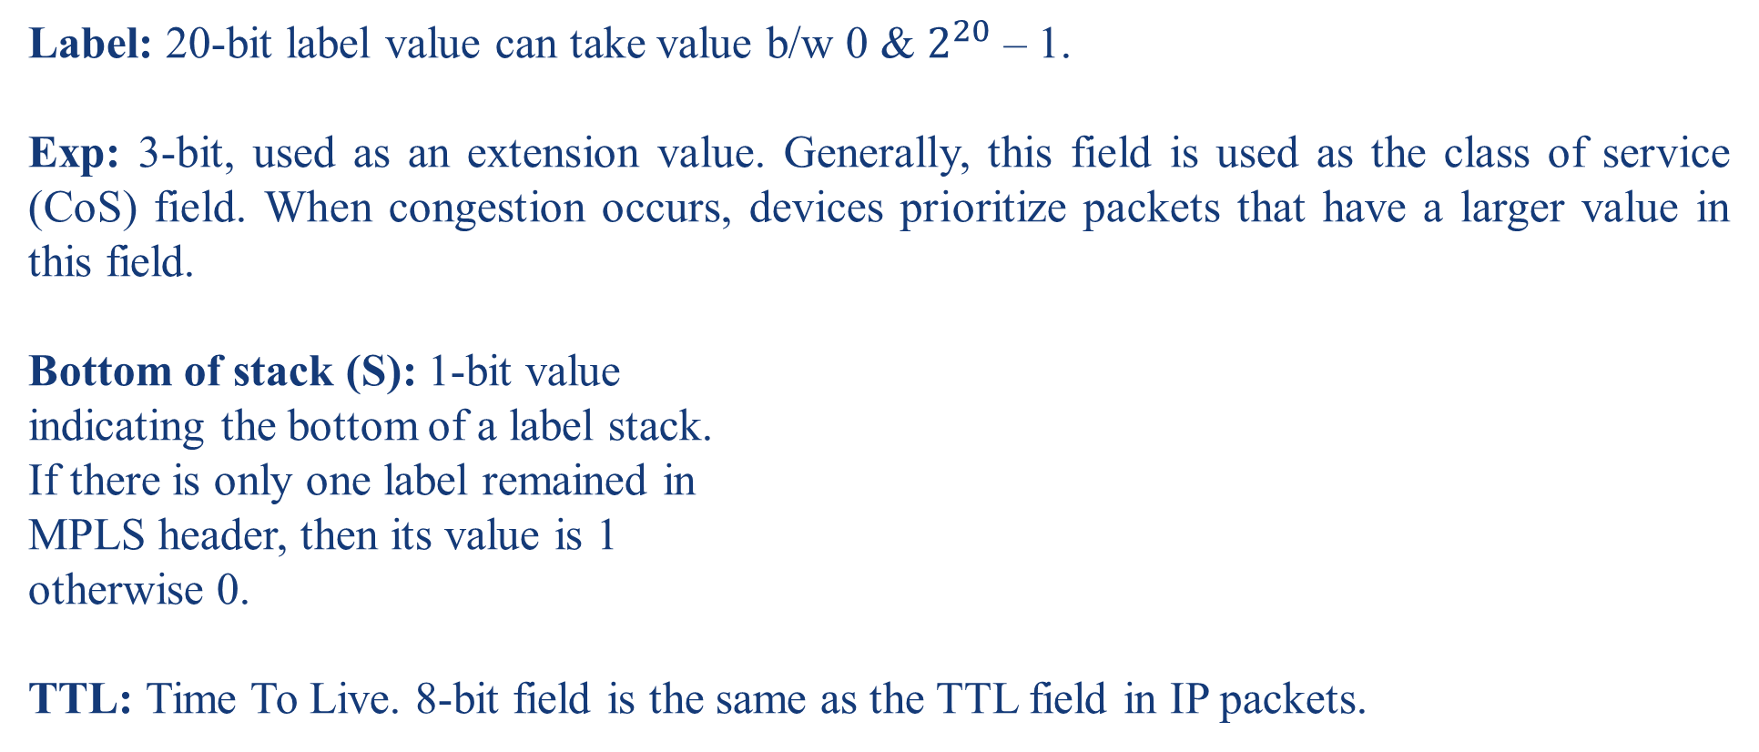
MPLS Label
Label: 20-bit label value can take value b/w 0 & $2^{20}$ – 1.
Exp: 3-bit, used as an extension value. Generally, this field is used as the class of service (CoS) field. When congestion occurs, devices prioritize packets that have a larger value in this field.
Bottom of stack (S): 1-bit value
indicating the bottom of a label stack.
If there is only one label remained in
MPLS header, then its value is 1
otherwise 0.
TTL: Time To Live. 8-bit field is the same as the TTL field in IP packets.

Slide 12
Forwarding in MPLS
LSRs receive IP packet CE and add an MPLS header in between layer 3 and layer 2 means it encapsulates the link-layer i.e., layer 2 frames. This feature allows LSRs to support receiving packets containing frames from different protocols like Frame Relay, Metro Ethernet, etc., that’s why it is called multi-protocol.
MPLS forwarding is based on label attached to IP packet. This label attachment is regulated by protocol called Label Distribution Protocol(LDP). Each LSR initially learns routes as normal routers do. This learning starts with PE routers. Each PE router learns routes to different subnets from CE router. Suppose PE router PE1 learns route to subnet (say subnet1) from CE router.

Slide 13
Forwarding in MPLS
Now PE1 will add label to packet, forward to its neighboring LSR, and tells them that if you receive packet which destination address to subnet1 then forward it to me.
Again this process is repeated by this LSR. In this way, LSR learns routes and add this information in Label Forwarding Information Base(LFIB). Now if any PE receives packet with destination to subnet1, then looking at labels and LFIB, LSRs can easily forward IP packet.

Slide 14
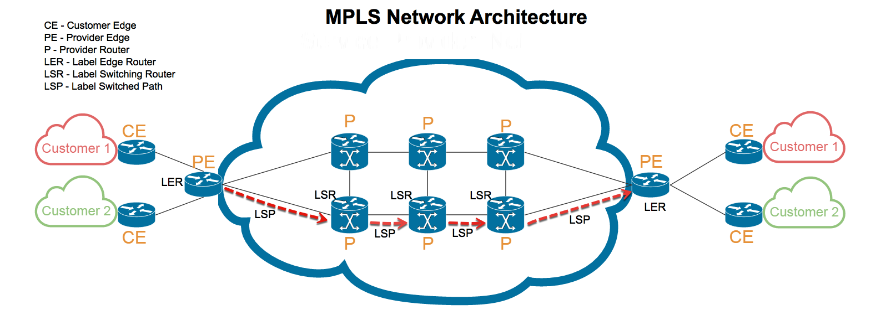
Forwarding in MPLS

Slide 15
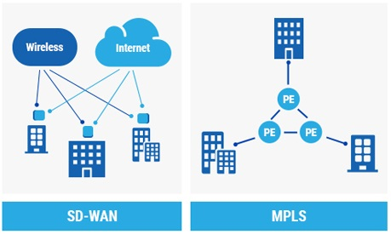
MPLS vs SD-WAN
Software Defined Wide Area Networking or SD-WAN is a transport-agnostic overlay that can route any type of traffic, including MPLS. a technology that uses the concept of Software Defined Networking to distribute network traffic over a WAN. SD-WAN automatically determines the most efficient way to route application traffic between branch and data center sites based on configured policies.

Slide 16
MPLS vs SD-WAN
By contrast, with MPLS, predetermined routes need to be painstakingly provisioned and once the fixed circuits are up, making changes is not point-and-click. But once an MPLS network is deployed, it delivers guaranteed performance for real-time traffic.
Many network professionals look at MPLS and SD-WAN as an either-or proposition. But SD-WAN is significantly less expensive to deploy and operate than MPLS.
Below is a comparison table between the technologys:

Slide 17
MPLS vs SD-WAN
 | MPLS | SD-WAN
Medium | Hardware | Software
Type of Network | Dedicated hardline | Virtual network
Data | High speed at a price but lower data loss. | Cost-effective but can suffer from network congestion and packet loss.
ISP Transport types | Limited | Limitless, including MPLS

Slide 18
MPLS vs VPN
VPN and MPLS differ from each other not only in the above mentioned aspects but also at cost, performance, application, etc. To be clear here lists the difference between VPN and MPLS in the following chart:
Parameters | VPN | MPLS
Technology Type | Point to Point and Multipoint technology. | Multipoint technology
OSI Layer | Works on up to Layer 7 | Works between Layer 2 and Layer 3
Encryption | Use encryption | Do not need encryption
Cost | Low | High
Traffic Prioritization | Not possible | Possible

Slide 19
MPLS vs VPN
Parameters | VPN | MPLS
Platforms Support | Supported on Routers (with relevant security license) and Firewalls | MPLS can be terminated at any layer 3 device
Multicast Support | Not supported on IPsec VPN | Support multicast traffic
Target Customers | Suitable for small to medium sized enterprises | Suitable for large-size enterprises
Traffic Control and Routing Decision | Customer has the control over traffic routing | Service provider has more traffic control and its routing
Cloud Based Services | Wide array of Cloud based services available for customers over Internet using VPN based connectivity | Limited availability of Cloud-based services for customers over MPLS

Slide 20
Conclusion
MPLS is a powerful and reliable protocol that allows for data to be routed quickly and securely. It is a great choice for large organizations that need to securely connect multiple geographically distant locations, and it can be used in a variety of applications.
Overall, MPLS is a useful tool for businesses that need to send sensitive data over the internet, on the negative side it does have some Disadvantages, such as its cost and complexity.

Slide 21
References
https://www.paloaltonetworks.com/cyberpedia/mpls-what-is-multiprotocol-label-switching
https://en.wikipedia.org/wiki/Multiprotocol_Label_Switching
https://www.networkworld.com/article/2297171/networking-mpls-explained.html
https://www.techtarget.com/searchnetworking/definition/Multiprotocol-Label-Switching-MPLS
https://www.gl.com/telecom-test-solutions/ethernet-networks-devices-switches/multi-protocol-label-switching-mpls-packetexpert.html
https://support.huawei.com/enterprise/es/doc/EDOC1000178173/b5b946d/mpls-label
https://www.geeksforgeeks.org/multi-protocol-label-switching-mpls/
https://www.catonetworks.com/what-is-mpls/mpls-vs-vpn-what-are-the-key-differences/#:~:text=MPLS'%20use%20of%20short%20labels,routing%20based%20on%20IP%20addresses.

